Slide 1

FROM AWARENESS TO PRACTICE:
BRINGING CULTURE INTO
THE COUNSELLING ROOM
Tomasz M. Rapacki, B.A.
(To contact the author, please send a message through
Prof. Dawn McBride at dawn.mcbride@uleth.ca)
A Project Submitted to the School of Graduate Studies of the University of Lethbridge in Partial Fulfillment of the Requirements for the Degree MASTER OF COUNSELLING

Slide 2
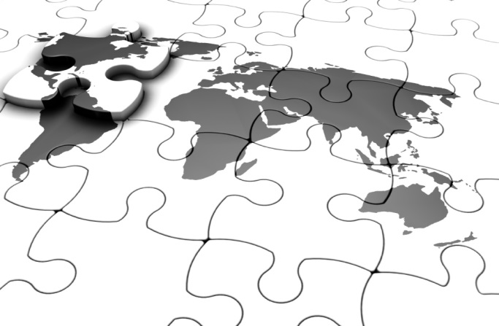



Please Note:
All images in this presentation are used with permission from their respective owners. Unless otherwise cited, the images used are from Microsoft’s Clip Art and Media gallery, which Microsoft has made available to customers for personal, educational, and non-profit applications.

Slide 3

Presentation Compatibility
This PowerPoint presentation was crafted with your ease-of-use in mind, and great effort was taken to achieve a crisp and consistent look across platforms. Unfortunately, due to technical limitations in the software, this presentation is only compatible with Microsoft Office 2007 or later for PC, and Office 2011 or later for Apple computers. Many essential interactive elements and fonts do not work for earlier versions.
If you don’t have a compatible version of Microsoft Office, you can still view a fully functioning version of the presentation in Microsoft’s free PowerPoint web app at www.skydrive.com. To do so, simply upload the file and click to view it online in the web app. This may require signing up for a free account.
If you find that some animations or ‘click to reveal’ elements are not working for you, you are welcome to exit the slide and review plain-text forms of the content in the notes pane below the slide in the edit view. Thank you for your understanding! ☺
Notes:
Url: www.skydrive.com

Slide 4
Disclaimer
This workshop is intended for use as part of a comprehensive cultural competency education program and under the direction of a qualified instructor. Participants are advised to employ any recommendations and techniques suggested only in combination with sound clinical judgment, consideration of a client’s individual characteristics and preferences, as well as in-depth knowledge of the client’s specific cultural group. Participants are encouraged to become familiar with the strengths and limitations of this workshop which are discussed in Chapter 6 of the literature review accompanying this workshop:
Rapacki, T. M. (2013). From awareness to practice: An online workshop on bringing culture into the counselling room. (Unpublished master’s project). University of Lethbridge, Lethbridge, AB, Canada.

Slide 5



Introduction to the Workshop
Caution: This is a lengthy presentation!
  This workshop is meant as an exploratory activity that may take up to 2–3 hours. There is a lot of information to take in, so you are invited to complete it over three sittings, one per day. The presentation is split into three sections by two recommended breaks.
  You are strongly encouraged to focus on the information you wish to follow up on, and to skim parts that you feel are less practical for your personal counselling approach.
Self-Evaluation Sheet:
  There is a self-evaluation sheet in the appendix of this project that is designed to help you note and remember the strategies and techniques you feel are most interesting.
  When you see this icon, please complete the next section of your evaluation!☺
Progress Bar:
  Periodically, a bar appears along the bottom of the screen to help indicate your progress. It is drawn to scale by number of slides.
You are here
I
II
D1
D2
D3
D4
D5
D6

Slide 6
Workshop Overview
Part I: The Need for Culturally Adapted Counselling
Part II: Introducing Culturally Competent Practice
Part III: From Theory to Practice with the PAMF
  Dynamic Issues & Cultural Complexities
  Orientation to Therapy
  Cultural Beliefs
  Client-Therapist Relationship
  Cultural Differences in Expression and Communication
  Issues of Salience
I
II
D1
D2
D3
D4
D5
D6

Slide 7
Part I:
The Need for Culturally Adapted Counselling and Psychotherapy

Slide 8
Need for a Culturally Adapted Approach
Please view the following video¹.
Without cultural competence we may focus on the therapeutic “game” as we know it, missing the gorilla of culture in the middle.
May also miss the importance of context (the curtains) and the working alliance could also be affected (i.e. a player leaving the game).
^{1:} Simmons (2010)
Notes:
Video available at: http://youtu.be/IGQmdoK_ZfY

Slide 9
The Canadian Challenge
Visible minorities as a proportion of major Canadian metropolitan centres¹:
17%
16%
25%
43%
42%
Toronto
Edmonton
Vancouver
Montreal
Calgary
The proportion of visible minority groups may double to up to one-in-three Canadians by 2031!¹
Canadians whose mother tongue is not English/French could also reach almost one-third¹
¹Statistics Canada (2010)

Slide 10
The Canadian Challenge
Implications:
  Responding to the needs of a diverse population is an important current need.
  This will also be a central future challenge for Canadian helping professionals.
^{1:} Statistics Canada (2010, pp.23,26)

Slide 11
Limitations of Existing Approaches:
“Cultural Encapsulation”^{1,2}:
  Approaches reflect upper-middle class values and culture³:
    Individualism
    Assertiveness
    Rationality
    Verbal/emotional expressiveness
    Abstract/ambigous communication
    Present-focus
    Use “Standard English”
    Strict time schedules
¹Kleinman, Eisenberg, & Good (2006); ²Wampold (2007); ³Sue & Sue (2008, pp.137–140)

Slide 12
Limitations of Existing Approaches:
Explanatory Models^{1,2}:
  Explanatory models include³:
    The nature of the problem
    The cause
    The treatment
  When client and counsellor’s explanatory models for mental illness don’t match, poorer diagnosis, treatment, and outcomes are likely to result¹.
¹Kleinman in Hwang, Myers, Abe-Kim, & Ting (2008, p.218); ²Kleinman, Eisenberg, & Good (2006);
³ See Kleinman et al. for a more in-depth analysis of explanatory models

Slide 13
Limitations of Existing Approaches:
Poorer Outcomes:
  A poor fit between mental health services and diverse populations is leading to^{1–5}:
    Underutilization
    Higher dropout
    Poorer outcomes
    ¹Kirmayer, du Fort, Young, Weinfeld, & Lasry (1996); ²Melfi, Croghan, Hanna, & Robinson (2000);
    ³Mok, Lao, Lin, Wong, & Ganesan, (2003); ⁴U.S. Department of Health and Human Services, 2001; ⁵Wang et al., 2005).

Slide 14
Advantages of Adapting Counselling¹
More ethical than implementing approaches “as-is”
More efficient than developing and training practitioners in new therapies for every single cultural group
Few evidence-based therapies are validated with different ethnic samples^{2,3}
    ¹Hwang (2006); ²Miranda et al. (2005); ³U.S. Department of Health and Human Services (2001)

Slide 15
Advantages of Adapting Counselling¹
Outcomes^{1–6}:
  Increased session smoothness
  Depth
  Satisfaction
  Perception of counsellor credibility
  Higher service utilization
  Decreased no-show and dropout
    ¹Benish, Quinana & Wampold (2011); ²Griner & Smith (2006); ³Huey & Polo (2008); ⁴Lefley & Bestman (1991); ⁵Leong (2007);
    ⁶Zane et al., (2005)

Slide 16
Conclusion
Culturally adapting counselling and psychotherapy is a viable and ethical option!
I
II
D1
D2
D3
D4
D5
D6

Slide 17

Part II:
Introducing Culturally Competent Practice

Slide 18
What is Culturally Competent Counselling?
D.W. Sue’s Cultural Competence Models^{1–3}
3 dimensions:
“self-awareness of own assumptions, values, and biases”
“Understanding the worldview of the culturally different client”
“Developing appropriate intervention strategies”
Each dimension encompasses knowledge, attitudes, and skills.
Culture-Infused Counselling Model⁴
3 dimensions:
“Awareness of personal assumptions, values, and biases”
“Understanding the worldview of the client”
“Culturally sensitive working alliance”
Each competency described in terms of knowledge, attitudes, and skills.
¹Sue, Arredondo, & McDavis (1992, p.481); ²Sue & Sue (2008); ³Sue et al. (1982); ⁴Collins & Arthur (2010, p.210)

Slide 19
Professional Guidelines
American Psychological Association’s 6 general guidelines¹:
Awareness of own attitudes, biases, and beliefs
Recognize importance of cultural sensitivity, responsiveness, and knowledge
Employ multiculturalism and diversity as constructs in psychological education
Encouraged to conduct ethical and culture-centred research with clients from minority backgrounds
Support organizational change and multicultural policy development
Apply culturally appropriate skills in clinical practice
¹American Psychological Association (2002)

Slide 20

Professional Guidelines
Canadian Psychological Association:
  Articulates how the 4 ethical principles¹ apply to non-discriminatory practice
  21 general guidelines², i.e.:
    Recognize the inherent worth of all people
    Awareness of own beliefs and how they affect others
    Recognize the reality of oppression
    Assessment of individual, situational, and cultural factors
¹Canadian Psychological Association (2000); ²Canadian Psychological Association (2001)

Slide 21
Advantages and Disadvantages for Practitioners
Cultural Competency Frameworks
  Comprehensive descriptions of cultural competency
  Highly complex: 34–300+ sub-factors
  Describe what competence is rather than how to achieve it
Cultural Competency Guidelines
  State the importance of cultural competence to the profession
  Concise
  Provide ethical standards and suggested directions
  Offer few specifics on how to achieve standards

Slide 22
A Third Option: Cultural Adaptation Frameworks
Advantages
  Articulate processes / principles for modifying therapy
  Utilization-focused, “how to” knowledge
  Contain specific methods, examples, and techniques
Disadvantages
  Build upon frameworks and guidelines
  Assume practitioner knows about and values cultural competency
  Still require practitioners to research individual minority groups
Implication: The most practical tool for practitioners, but not a replacement for cultural knowledge and experience¹.
¹Hwang (2006)

Slide 23


Ecological Validity Model¹ (EVM)
Please click the icons to explore the 8 areas of therapeutic modification in the Ecological Validity Model!
    Incorporate cultural sayings, images, and symbols to explain therapeutic concepts
    Understandable
    Culturally appropriate
    Conveys understanding and respect of cultural values
    Build therapeutic relationship
    Create comfort between counsellor and client
Language
Persons
Metaphors
Content
    Use culturally familiar techniques
    Treatment concepts framed within cultural values
    Agreement on explanatory model for illness and treatment
    Avoid Western tendency for individualistic assessment and treatment
    View client within environmental and social context (economic, historical, familial, social class, etc.)
    Mutual agreement
    Adaptive and acceptable within cultural context
Concepts
Goals
Methods
Context
¹ Bernal, Bonilla, & Bellido (1995)
Notes:
Language: Understandable; Culturally appropriate
Persons: Build therapeutic relationship; Create comfort between counsellor and client
Metaphors: Incorporate cultural sayings, images, and symbols to explain therapeutic concepts
Content: Conveys understanding and respect of cultural values
Concepts: Treatment concepts framed within cultural values; Agreement on explanatory model for illness and treatment
Goals: Mutual agreement; Adaptive and acceptable within cultural context
Methods: Use culturally familiar techniques
Context: Avoid Western tendency for individualistic assessment and treatment; View client within environmental and social context (economic, historical, familial, social class, etc.)

Slide 24
Ecological Validity Model¹ (EVM)
  Specific areas to explore for adaptation
  Easy to understand labels
  A leading adaptation framework in the field:
    2 RCTs with Puerto Rican Adolescents^{1,2}
    Studies with Mexican-American and Haitian individuals/families^{3–6}
  Relatively few specific examples
  Focused primarily on Hispanic cultures
  Intended for designing counselling programs moreso than individual practitioners
  Primarily used with group/family/psychoeducational interventions
    ¹Rossello & Bernal(1999); ²Rossello, Bernal, & Rivera-Medina (2008); ³Domenech-Rodriguez(2008); ⁴Matos, Torres, Santiago, Jurado, & Rodríguez (2006); ⁵McCabe, Yeh, Garland, Lau, & Chavez (2005); ⁶Nicolas, Arntz, Hirsch, & Schmiedigen (2009)

Slide 25
Psychotherapy Adaptation and Modification Framework (PAMF)¹
Consists of 6 domains with 25 therapeutic principles
Each principle is a practical suggestion
All principles are explained by a cultural rationale for why they would be effective
I
II
D1
D2
D3
D4
D5
D6
¹ Hwang (2006)

Slide 26
Psychotherapy Adaptation and Modification Framework (PAMF)¹
The 6 domains of the PAMF:
Dynamic issues and cultural complexities
Orienting clients to psychotherapy
Understanding cultural beliefs about illness and treatment
Improving the client-therapist relationship
Understanding cultural differences in expression and communication of distress
Addressing culture-specific issues
¹ Hwang (2006)

Slide 27
Psychotherapy Adaptation and Modification Framework (PAMF)¹
  Dual purpose design²
    Creating adapted psychotherapies
    And helping practitioners bridge from abstract knowledge to concrete skills
  Numerous examples, 25 practical principles¹
  Challenges practitioners to justify adaptations (avoid applying them haphazardly)
¹ Hwang (2006); ²Hwang (2012)

Slide 28
Psychotherapy Adaptation and Modification Framework (PAMF)¹
  Currently undergoing an RCT²; demonstrated in case study³
  Most current framework to date ⁴
  Domain labels may be less intuitive
  Some principles are Asian-focused
  But most are widely applicable
¹ Hwang (2006); ²Hwang (2012); ³Hwang, Wood, Lin, & Cheung (2006); ⁴Hwang (2009)

Slide 29
Conclusion
Cultural competency frameworks define what cultural competence is
Professional guidelines convey its importance and set standards
Adaptation frameworks are helpful for applying cultural knowledge
An important goal for the PAMF is helping individual practitioners bridge from knowledge to practice, so we will discuss adapting our therapeutic services from its perspective
But both EVM and PAMF are respected, practical frameworks for therapeutic adaptations!

Slide 30
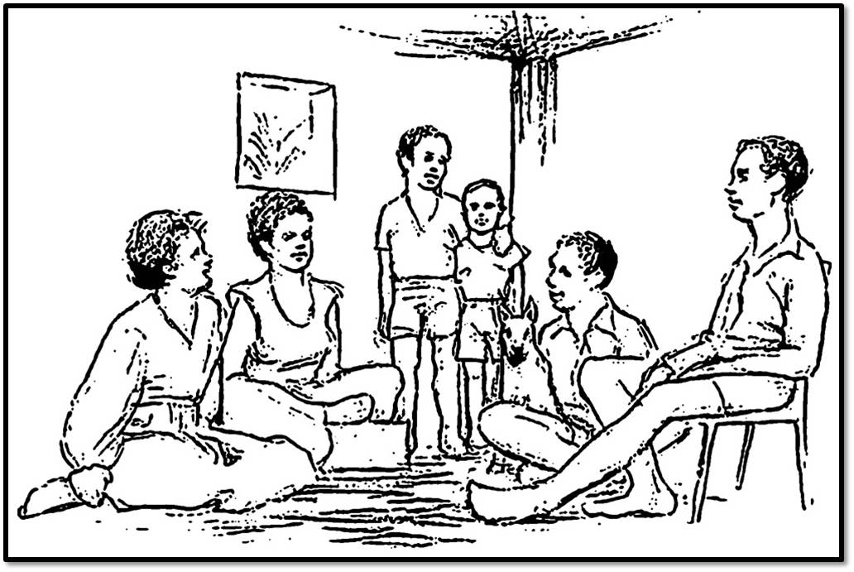
Culture Break ☺
What do you see in this picture?
Urban legend¹ suggests that this ambiguous picture (source unknown), appears as a family sitting under a tree and a woman with a basket on her head to members of some African cultures. To what degree do you think reality may be culturally constructed?
¹ Vision Health (2009)
Notes:
Url: http://www.eyes-and-vision.com/influence-of-culture-on-visual-perception.html

Slide 31
Part III:
From Theory to Practice with the PAMF

Slide 32
Overview of Part III Topics
Domain I: Dynamic Issues & Cultural Complexities
Domain II: Orientation to Therapy
Domain III: Cultural Beliefs
Domain IV: Client-Therapist Relationship
Domain V: Cultural Differences in Expression and Communication
Domain VI: Cultural Issues of Salience
I
II
D1
D2
D3
D4
D5
D6

Slide 33
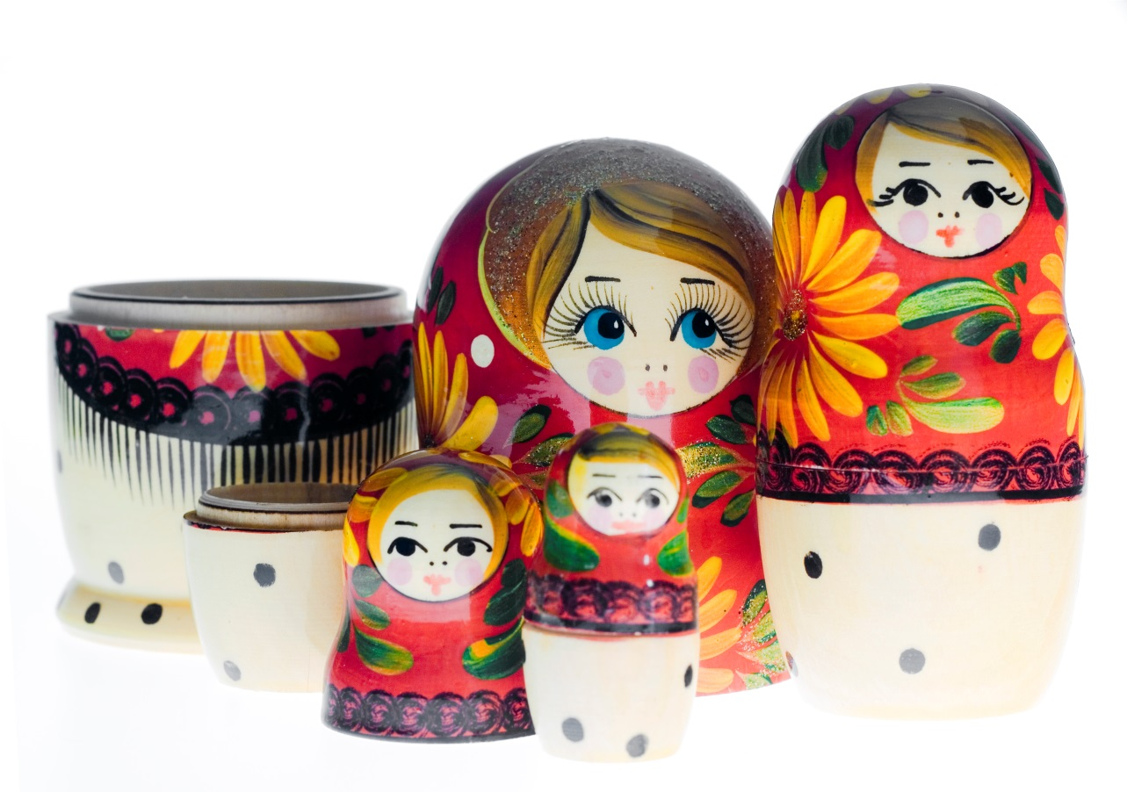
Domain 1: Dynamic Issues & Cultural Complexities

Slide 34
Dynamic Issues & Cultural Complexities: Overview
Refers to:
  Addressing clients’ multiple, complex identities¹
  Dynamic sizing: dynamically adjusting focus between cultural vs. individual-focused treatments²
¹ Hwang (2006); ²Sue (1998)

Slide 35
Dynamic Issues & Cultural Complexities: Components
Benefits:
  Protects working alliance from two opposite excesses: cultural blindness vs. stereotyping based on group characteristics¹
  Addresses the most salient identities for a client²
    A Korean-Canadian may not hold “Korean” values and not desire Korean-centered interventions like doing a family genogram³
    An African-Canadian may seek help for coping with family rejection due to being a Gay rather than of prejudice because of being Black
  Allows full integration of cultural competence⁴ through recognizing that all counselling is multicultural counselling²
¹Sue (1998); ²Arthur & Collins (2010); ³Matsumoto & Juang(2008); ⁴Parham in Gallardo, Johnson, Parham, & Carter (2007, p.432)

Slide 36

Dynamic Issues & Cultural Complexities: Components
Assess self-esteem accurately
Assess acculturation and incorporate personal values
Address minority identity development
Understand personality in context

Slide 37
Self-Esteem and Collectivism
Collectivist societies value modesty and avoid boasting about self-efficacy / individual ability (i.e. Japanese, Chinese, First Nations^{1–3})
Western self-esteem is a much weaker indicator of mental health in non-western cultures⁴ i.e. only has half the power to predict depression in Hong Kong vs. American students⁵
Collectivist peoples speak highly of their collectivist (interdependent) strengths instead: loyalty, cooperation, compromise, maintaining group harmony, etc.⁶
¹California State Department of Education (1982); ²Redpath & Nielsen (1997); ³Tafarodi & Swann (1996); ⁴(Diener & Diener (1995);
⁵Chen, Chan, Bond, & Stewart (2006); ⁶Sedikides, Toguchi, & Gaertner (2003)

Slide 38
Self-Esteem: Applications
Include interdependent traits in self-esteem assessment: fitting in, perceived social competence, compromise, respect, and commitment to the group.
i.e., “I like to working together with others”, “I am told I am respectful and a good listener”, “when there are conflicts in my group, we’re able to compromise”.
Ask about group membership: just like sports fans, or University Alumni, clients may give clues to their self-esteem by expressing positive feelings about their groups.
Asking “what would your mother, friend (or other significant person) say are your strengths?” is more modest and culturally acceptable¹
¹Hays (2009, p.357)

Slide 39

Dynamic Issues & Cultural Complexities: Components
Assessing acculturation and incorporating personal values
I
II
D1
D2
D3
D4
D5
D6

Slide 40
Acculturation and Values
Acculturation reflects values, cultural knowledge, and preferences¹
Can be thought of as bidirectional and unidirectional:
  Unidirectional: towards taking on a new culture
  Bidirectional: commitment towards ethnic and host cultures considered separate
Bidirectional Acculturation Strategies¹
Host culture
Separation
(Traditional)
Integration
(Bi-cultural)
Ethnic culture
Marginalization
(Alienated)
Assimilation
(“Canadianized”)
¹Flannery, Reise, & Yu (2001)

Slide 41
Acculturation and Values
No single acculturation strategy consistently produces superior mental health outcomes.^{1,2}
Perhaps clients must find the best “fit” for them?
But acculturation to Western values increases help-seeking from Western mental health practitioners in a variety of cultural groups^{3–5}
¹Yoon, Langreher, & Ong (2011); ²Matsumoto & Juang (2008, pp.391–393); ³Frey & Roysircar (2006); ⁴Keefee (1982);
⁵Walace & Constantine (2005).

Slide 42
“Cultural Reaffirmation Effect”
Immigrant groups may hold stronger traditional values than those in their home country
Traditions crystalize at the time of immigration, while the old country globalizes and changes^{1,2}
Implication: We may see parents or family members that appear hypertraditional, this does not necessarily imply a defensive reaction
¹Kosmitzki (1996); ²Matsumoto, Weissman, Preston, Brown, & Kupperbusch (1997)

Slide 43
Acculturation & Values: Applications
Use clients’ level and strategy of acculturation to inform how to “size” cultural interventions
Personalize statements to recognize cultural values without conveying stereotypes (i.e. ‘family is important to you’ vs. ‘family is important to Asians’)¹
But do make cultural statements to normalize stigmatized experiences or emphasize the customization of a program²
¹Hwang (2009, p.372); ²Hwang (2012)

Slide 44
Acculturation & Values: Applications
Acculturation may be assessed formally through the General Ethnicity Questionnaire(GEQ¹), Vancouver Index of Acculturation(VIA²), and Asian Values Scale (AVS³)
A comprehensive list of measures is available here⁴
Assist a client with finding and employing their preferred strategy for acculturation
¹Tsai, Ying, & Lee (2000); ²Ryder, Alden, & Paulhus (2000); ³Kim, Atkinson, & Yang (1999); ⁴Taras(2011)
Notes:
http://www.vtaras.com/Acculturation_Survey_Catalogue.pdf

Slide 45
Acculturation & Values: Applications
Emphasizing acculturation as bi-directional, developing competency to navigate 2+ cultures rather than giving up the home culture may assist families struggling with acculturation conflicts
If unsure how to dynamically size interventions, ask the question: “what role does your culture, discrimination, etc. have in all this”?

Slide 46

Dynamic Issues & Cultural Complexities: Components
Addressing minority identity development
Please fill out self-evaluation sheet domain 1, sections 1 & 2. ☺
I
II
D1
D2
D3
D4
D5
D6

Slide 47

Racial/Cultural Identity Model (R/CID)¹
Conformity
    Desire to choose own values rather than rigidly accepting those of their minority group.
    Feels conflicted between group solidarity / loyalty and personal autonomy
    Experience pride in their culture but select their own values
    Seek understanding of other cultural groups and perspectives
    Selectively appreciate positive contributions and individuals from the dominant culture
    May view racism as a societal affliction
    Feeling conflicted between appreciating one’s own cultural group and the dominant cultural group
    Becoming more aware of racism and starting to hold suspicions of majority culture
    Culturocentric; elevating own group’s values while denigrating the dominant group
    Strong blame of the majority for oppression and racism
    Sharing values of the dominant group
    Adopting a self-deprecating / disregarding attitude towards own group and other minority groups
Please click the titles to learn about the 5 stages of racial/cultural identity development
☺
Dissonance and appreciating
Resistance and immersion
Introspection
Integrative awareness
¹ Sue and Sue (2008, pp.242–258)
Notes:
Conformity: Sharing values of the dominant group; Adopting a self-deprecating / disregarding attitude towards own group and other minority groups
Dissonance and appreciating: Feeling conflicted between appreciating one’s own cultural group and the dominant cultural group; Becoming more aware of racism and starting to hold suspicions of majority culture
Resistance and immersion: Culturocentric; elevating own group’s values while denigrating the dominant group; Strong blame of the majority for oppression and racism
Introspection: Desire to choose own values rather than rigidly accepting those of their minority group; Feels conflicted between group solidarity / loyalty and personal autonomy
Integrative Awareness: Experience pride in their culture but select their own values; Seek understanding of other cultural groups and perspectives; Selectively appreciate positive contributions and individuals from the dominant culture; May view racism as a societal affliction

Slide 48

Minority Identity Development: Applications¹
Conformity:
  Prefer a European-American therapist
  Respond best to problem solving approach - exploring identity may be threatening, revealing negative feelings, low self-esteem
  Work on problem-focused goals, but attempt to raise consciousness later about the reality of oppression¹
Dissonance and appreciating:
  Provide validation of reality of oppression
  Encourage contact with strong individuals of their cultural group.
¹ Sue and Sue (2008, pp.242–258)

Slide 49
Minority Identity Development: Applications¹
Resistance and immersion:
  Often prefer therapist of own cultural group
  Build trust through increased self-disclosure
  React non-defensively to resentment & accusations
  Use relationship to teach new ways of relating to majority culture (empowered but not hostile)
  Encourage social action and external change efforts
  Ally against prejudice
Introspection:
  Explore identity issues
  Explore conflict between autonomy and cultural group
  Validate that striving for personal autonomy ≠ disloyalty to their cultural group
¹ Sue and Sue (2008, pp.242–258)

Slide 50
Minority Identity Development: Applications¹
Integrative awareness:
  Often prefer counsellors with similar worldviews, i.e. anti-prejudice
  Counsellor may act as a facilitator of efforts for positive community and societal change
¹ Sue and Sue (2008, pp.242–258)

Slide 51
Dynamic Issues & Cultural Complexities: Components
Understanding personality in context
I
II
D1
D2
D3
D4
D5
D6

Slide 52
Personality
Addressing personality, culture, and universal needs / motives are all part of a holistic conceptualization of the client and their challenges^{1–4}.
Universal Humanity (Biological Context)
Culture (Sociocultural Context)
Personality (Individual Dynamics)
¹Leong (1996); ²Leong (2007); ³Sue & Sue (2008); ⁴Hofstede, Hofstede & Minkov (2010)

Slide 53
The “Big 5”of Personality¹
Openness
Conscientiousness
Agreeableness
Extroversion
Neuroticism
The ‘universal’ big five/five factor model of personality has been validated across more than 50 cultures^{1,2} but there are considerable aggregate personality differences in traits
Comparing Canadians to other nations can help us understand ourselves in context
The next slides compare Canadian university students to those from select other countries, plotted against the world average
¹McCrae, Yik, Trapnell, Bond, & Paulhus (1998); ²McCrae & Terracciano (2005a)

Slide 54
Optional Activity
Interested in having some fun and comparing your personality traits to country averages on the next few slides?
To do so, take the 50-question IPIP NEO short form here¹, which is provided for educational purposes, but correlates highly with the NEO-PI-R used for the country data²
You will get percentile scores for Extraversion, Agreeableness, Conscientiousness, Neuroticism, and Openness to Experience which you can convert to “world average” scores on the table in the next slide for comparison with the country data
If you choose this activity, please be aware that it is for educational purposes only and that scores will only be estimates because the two tests and norms are related but not directly comparable! ☺
¹ Johnson (2001); ²Goldberg (1999)
Notes:
Url: http://www.personal.psu.edu/j5j/IPIP/

Slide 55
Optional Activity
IPIP NEO to “World Score” Conversion Table
IPIP NEO Score | “World Score” | IPIP NEO Score | “World Score”
1 | -23 | 55 | 1
5 | -16 | 60 | 2
10 | -13 | 65 | 4
15 | -10 | 70 | 5
20 | -8 | 75 | 7
25 | -7 | 80 | 8
30 | -5 | 85 | 10
35 | -4 | 90 | 13
40 | -2 | 95 | 16
45 | -1 | 99 | 23
50 | 0

Slide 56
Neuroticism
Extroversion
More Extroverted
World average = 0, SD = 10¹
¹McCrae & Terracciano (2005a)

Slide 57
Openness
Agreeableness
World average = 0, SD = 10¹
¹McCrae & Terracciano (2005a)

Slide 58
Conscientiousness
World average = 0, SD = 10¹
¹McCrae & Terracciano (2005a)

Slide 59
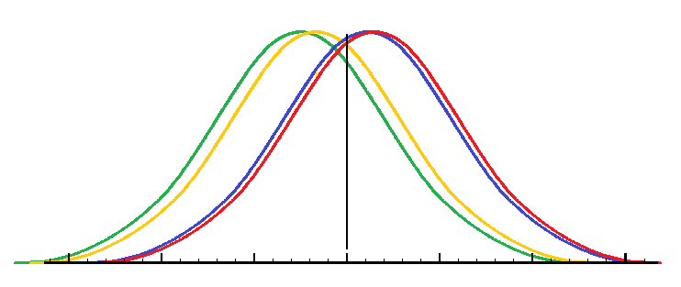
Personality Comparisons
Canadians (or at least Canadian university students) may be more extroverted than the international average¹ particularly compared to China, Russia, Nigeria, etc.
Comparison of Extroversion Scores
China
U.S.A
Nigeria
Canada
-30 -20 -10 0 10 20 30
¹McCrae & Terracciano (2005a)

Slide 60
Personality Comparisons
Personality differences from American culture decrease among Asian-American immigrants with acculturation^{1,2}
Neuroticism was found to be elevated but decreased with acculturation. –Evidence of acculturative stress?²
Personality has individual, universal, and cultural components³
Culture-specific personality models exist as well, i.e., for East Indian, Japanese, Mexican, and Filipino peoples⁴
¹McCrae, Yik, Trapnell, Bond, & Paulhus (1998); ²Teng, Dere, & Ryder (2008) ³Matsumoto & Juang (2008, p.279); ⁴Church (2000)

Slide 61
Simpatia
‘Simpatia’ a personality trait in Hispanic cultures:
Likeable, easygoing, polite, fun to be with, affectionate, enjoys sharing feelings with others¹
Implication: May indicate that Hispanic clients expect more warm, inviting counselling relationships
I
II
D1
D2
D3
D4
D5
D6
¹Ramirez-Esparza, Gosling, & Pennebaker (2008)

Slide 62
The CPAI
The Chinese Personality Assessment Inventory-2 (CPAI-2)¹
Explains many personality traits important to Chinese culture
Focuses on interpersonal relationship “blind spot” in Western models²
¹Cheung, Leung, Song, & Zhang (2001); ²Cheung et al. (2001)

Slide 63
The CPAI
‘Interpersonal relatedness’ dimensions like:
  Social sensitivity
  Reciprocal relationship orientation
  Harmony
Also, other traits assessed important to the Chinese context: saving face, traditionalism / modernity, self vs. social orientation, social sensitivity, thrift / extravagance^{1,2}
¹Cheung, Cheung, Wada & Zhang (2003); ²Cheung, Leung, Song, & Zhang (2001)

Slide 64
The CPAI
Validated in a large psychiatric sample¹
Clinical scales effectively differentiate prison inmates and psychiatric inpatients from healthy respondents²
Interpersonal relationship dimension also replicated in Chinese-Americans and European-Americans³
Implication: Evidence of Western theory “blind spots” to relational / interpersonal context
¹Cheung (2007); ²Cheung, Kwong, & Zhang (2003); ³Lin & Church (2004)

Slide 65
Personality: Applications
Limit weighting of personality assessment conclusions based on Western or limited cultural norms
Exploring national personality differences, consider interpreting personality differences similar to home cultural averages as normal cultural differences
Consult McCrae & Terracciano (2005b) and Schmitt, Allik, McCrae, & Benet-Martinez (2007) for a comparison of 56 countries.

Slide 66
Personality: Applications
Consider that newcomer neuroticism scores may reflect normal acculturative stress, use as opportunity to provide assistance
Consider using indigenous personality tests or concepts to increase client buy-in:
  “What else is there to know about your personality?”
  “Do people describe you as having simpatia?”
  “Do you attach great importance to reciprocity in personal relationships?”

Slide 67
Reflection Questions
What might an interpersonal context “blind spot” in Western theories mean for our practice with diverse clients?
If you took the IPIP NEO, you likely found many of your scores were off the charts compared to the country averages. What does that say about the size of individual differences versus between-group differences?
You’re doing great! ☺
How about a break?
I
II
D1
D2
D3
D4
D5
D6

Slide 68
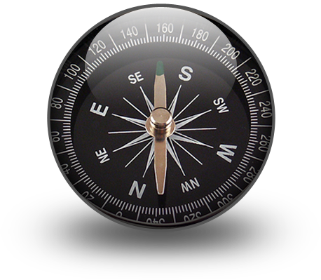
Domain II: Orientation to Therapy
Please fill out evaluation sheet domain 1, sections 3–4. ☺

Slide 69
Thought Experiment
Suppose you were appointed as a diplomat tomorrow and invited to dine with the royal family. Would you know all of the points of Western etiquette and fine dining? Would you know exactly which utensil to use when, where to sit, how to address the Queen and all of the members of the royal family?
How might you feel if you went to the dinner without knowing these rules? How might clients from a different culture feel attending counselling, not being familiar with the rules and roles of counselling?

Slide 70
Orientation to Therapy: Overview
Refers to¹:
  Providing an orientation and explanation to the expectations of and unique ‘culture’ of therapy.
  Changing structure and focus of sessions to be more in line with client expectations
¹Hwang (2006)

Slide 71

Orientation to Therapy: Components
Providing an orientation to therapy
Respond to therapeutic expectations
Establish goals/structure

Slide 72
Orientation: Applications
Make time for a longer, more detailed orientation^{1,2}
Educate explicitly about roles and expectations in therapy
Explain the typical course of therapy
Build rapport by emphasizing confidentiality, ³
Discuss healthy therapeutic termination to reduce dropout¹
Reduce stigma by articulating a holistic / biopsychosocial model that doesn’t make the client feel personally blamed for their illness ^{1,4}
¹Hwang (2006); ²Hwang (2009); ³Sue & Sue (2008); ⁴Hays (2009)

Slide 73
Orientation to Therapy: Components
Responding to therapeutic expectations
I
II
D1
D2
D3
D4
D5
D6

Slide 74
Responding to Expectations: Applications
Consider a more directive, active, expert approach preferred by most cultural groups^{1–7}
Problem-focused, time-limited approaches (CBT, BT, SFT) often fit well with more concrete expectations of diverse clients²
¹Sue & Zane (1987); ²Sue & Sue (2008); ³Lafromboise, Trimble, & Mohatt (1990), ⁴Al-Krenawi & Graham (2000), ⁵Li & Kim (2004);
⁶Kim, Li, &, Liang (2002); ⁷Rossello, Bernal, & Rivera-Medina (2008)

Slide 75
Responding to Expectations: Applications
Directly address clients receiving less initial benefits due to acclimatization time to foreign therapeutic culture / waiting longer to seek help¹
Offer the gift of a small solution early on as an example and to provide motivation²
Being more directive does not mean being paternalistic³ this can remind clients of historical and current oppression
¹Hwang (2009); ² Sue (1998); ³Gonzalez-Prendes, Hindo, & Pardo (2011)

Slide 76
Reflection Questions:
Which cultural groups in Canada and the United States have historically been mistreated in a paternalistic way?
How might you communicate an expert approach without disempowering them?

Slide 77

Orientation to Therapy: Components
Establishing Goals and Structure

Slide 78
Establishing Goals/Structure: Applications
Emphasize co-constructing therapy¹:
  Be directive and explicitly structure sessions
  Give guidelines of responses expected
  Emphasize client’s role as expert in their life
  Provide a choice of activities
  Encourage development of own solutions
  Look to the client to set treatment goals
Focus on alleviating symptoms¹
Establish frequent goals and markers of treatment progress with periodic review to appeal to concrete-oriented clients²
¹Sue & Sue (2008); ²Hwang (2009)

Slide 79

Domain III: Cultural Beliefs
Please fill out self-evaluation sheet domain 2
I
II
D1
D2
D3
D4
D5
D6

Slide 80
Cultural Beliefs: Introduction
Providing a familiar structure for new information allows the brain to organize it in a meaningful way, enhancing recall^{1–3}
For example, stories and metaphors can enhance information processing in CBT⁴
Integrating cultural beliefs, meanings, symbols, stories, and metaphors facilitates the therapeutic change process⁵
The following exercise demonstrates how meaning making can enhance cultural learning
¹Brouillet, Marshall, & Andrews (1987); ²Ormrod (2012); ³Philips (2002); ⁴Otto (2000); ⁵Hwang (2006)

Slide 81
Cultural Meanings Exercise
On the next screen, you will see 7 Chinese characters paired with their English translations.
Please remember as many meanings as you can after studying the list for 45 seconds. The slide will time this on its own.
When you’re ready, click to the next slide (or if you don’t wish to participate, you may skip the next few slides).

Slide 82
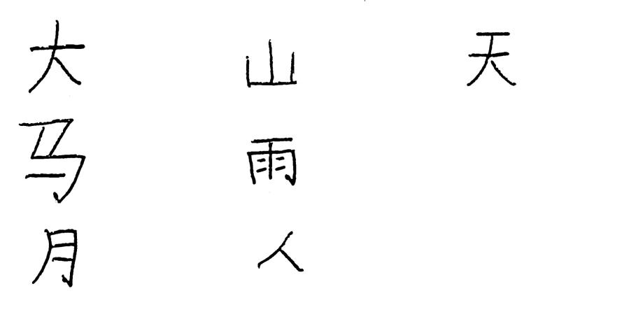
Study Slide
Big
Mountain
Heaven
Horse
Rain
Person
Moon
Thank you! Please click to proceed to the ‘test’ slide!

Slide 83






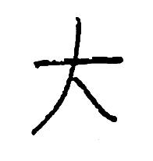
Test Slide
Mountain
Person
Horse
Rain
Heaven
Moon
Big
Click each picture to get the correct answer, or click anywhere else to advance to the next slide.

Slide 84
Cultural Meanings Exercise
How many did you get right?
This time let’s enhance our learning by using cultural meaning making.
Follow the same procedure as last time, and we will test how much you’ve learned after 45 seconds.
Click to advance to the study slide (You are still free to skip this section if you don’t wish to participate).

Slide 85
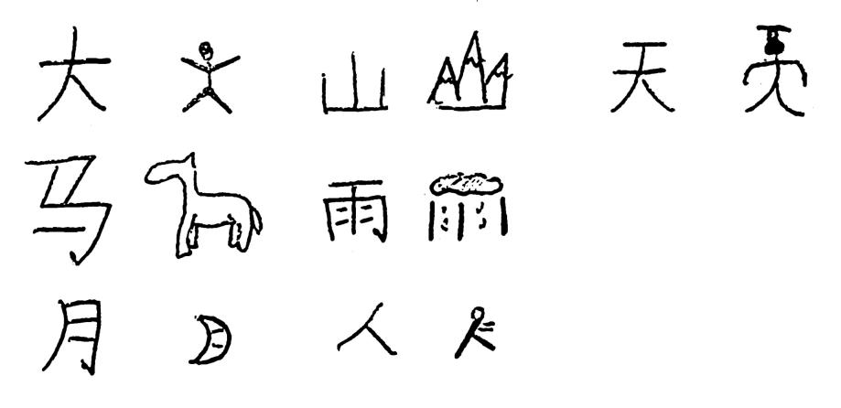
Study Slide
Big
Mountain
Heaven
Horse
Rain
Moon
Person
Thank you! Please click to proceed to the ‘test’ slide!

Slide 86

Test Slide
Moon
Horse
Big
Heaven
Person
Rain
Mountain
Click each picture to get the correct answer, or click anywhere else to advance to the next slide.

Slide 87
Cultural Meanings Exercise
Was it easier to remember the characters the second time? Chances are that if you weren’t already familiar with a similar character system, connecting this new information to familiar concepts helped you to learn and remember.
If you were already familiar with these or similar characters, how might your study process differ with those who weren’t?
Practitioners can take advantage of cultural meanings to enhance therapeutic effectiveness with diverse clients.¹ ☺
*Please note that the use of mnemonic pictures in this exercise was for demonstration only, and was not meant to imply that modern Chinese characters are pictographs. They are not.
¹Hwang (2006)

Slide 88
Cultural Beliefs: Overview
Refers to¹:
  Understanding cultural beliefs about illness and treatment
  Integrating cultural systems, beliefs, meanings, and strengths to enhance treatment
  Maintaining awareness and responsiveness to how beliefs affect help-seeking and treatment preferences
¹Hwang (2006)

Slide 89
Cultural Beliefs: Overview
Benefits^{1,2}:
  Facilitates client understanding and adherence to treatment
  Increases client comfort
  Makes treatment more culturally congruent
  Takes advantage of existing strengths and healing pathways
  Addresses the stigma of counselling by presenting a familiar cultural model
  May enhance the perceived relevance, recall, and behaviour change from therapeutic concepts³
¹Hwang (2006); ²Hwang(2009); ³Otto (2000)

Slide 90

Incorporating Cultural Beliefs: Components
Adopting a holistic, psychoeducational approach
Utilize cultural bridging techniques
Integrate cultural beliefs, strengths, and resources into treatment
Reduce stigma surrounding help-seeking and the counselling process
I
II
D1
D2
D3
D4
D5
D6

Slide 91
Holistic, Psychoeducational Approach: Applications
Educate clients in a biopsychosocial model of mental illness that does not place the blame solely on the client and their cognitions^{1,2}
Maintain a more systemic focus, especially with clients who identify with collectivistic values or struggling with societal prejudice³
Help resolve relational/social conflicts^{2,4}
¹Hwang (2006); ²Hays (2009); ³Sue & Sue (2008, pp.180, 254, 256); ⁴Hwang (2009)

Slide 92
Holistic, Psychoeducational Approach: Applications
Explicitly explore the consequences of interventions for the client’s whole family¹
Simplify material, reduce learning load, consolidate complex topics²
Increase time for teaching unfamiliar concepts², consider increasing session length if necessary
¹Sue & Sue (2008, p.370); ²Hwang (2009)

Slide 93
Incorporating Cultural Beliefs: Components
Utilizing cultural bridging techniques

Slide 94
Cultural Bridging
“Cultural Bridging” involves using cultural sayings, metaphors, or cultural beliefs to present therapeutic concepts^{1,2}
Application examples follow:
¹Hwang (2006); ²See also Rossello & Bernal (1999)

Slide 95
Cultural Bridging: Yin & Yang
Yang Qi 阳气
Yin Qi 阴气
Sun
Light
Positive
Life
Male
Heat
Vigour
Moon
Darkness
Negative
Death
Female
Cold
Relaxation
Chinese traditional medicine views the body and mind as interconnected and stresses Daoist beliefs about the need for balance of complementary Yin Qi & Yang Qi (dark and light energy)¹
¹Hwang (2012)

Slide 96
Cultural Bridging: Yin & Yang
Using Yin & Yang to introduce CBT techniques¹:
  Sitting in the sun and imagining influx of positive Yang energy as a behavioural activation exercise
  Presenting cultivating positive cognitions as improving one’s balance of qi
  Emphasizing balanced thinking and action
  Promoting culturally-congruent physical activities (tai ji, qi gong, meditation) by rationale of mind-body holism
¹Hwang (2012)

Slide 97

Cultural Bridging: Medicine Wheel
Canadian Aboriginal spirituality also views wellness as holistic ^{1–3}, a balance between Mental, Spiritual, Physical, and Social/Emotional
When one area is out of balance, all areas suffer
Each aspect of the medicine wheel can be used to introduce different elements of counselling in the service of balance¹ , i.e.:
  Physical = Physical self-care, action strategies, nature, economic conditions
  Mental = Cognitions, psychoeducation, anti-colonialist philosophy
Mental
Reason
Logic
Spiritual Wisdom
Vision
History
Social
Emotional
Community
Rel’ships
Physical
Economics Action
¹Absolon (2010); ²Verniest (2006); ³Wenger-Nabigon (2010)

Slide 98
Cultural Bridging: Medicine Wheel
The medicine wheel can be a tool for decolonization: presents Aboriginal as equal to Western knowledge¹
Using the medicine wheel promotes cultural reconnection, a healing intervention for Aboriginal peoples²
Cultural continuity in Aboriginal communities was found to be strongly related to decreased suicide rates³
Mental
Reason
Logic
Spiritual Wisdom
Vision
History
Social
Emotional
Community
Rel’ships
Physical
Economics Action
¹Absolon (2010); ²Stewart (2008); ³Chandler & Lalonde (1998)

Slide 99
Cultural Bridging: Medicine Wheel
Optional: Practitioners could also research and make use of the Indivisible Self model of wellness¹ to provide counselling to clients with holistic mental health beliefs
Thinking, Emotions, Control, Work, Positive Humour
Leisure, Stress-Management, Self-Worth, Realistic Beliefs
Creative
Coping
Exercise, Nutrition
Friendship, Love
Physical
Social
Spirituality, Gender Identity, Cultural Identity, Self-Care
Essential
¹Myers & Sweeney (2008)

Slide 100
Cultural Bridging: Cultural Sayings
Cultural values, proverbs, and sayings can also be used to explain therapeutic concepts, click below if you’d like to explore some examples:
Chinese Chengyu
(proverbs):
Mexican-American/Latino Dichos (folk sayings):
双管齐下
Al que no ha usado huaraches, las correas le sacan sangre¹
山不转路转，路不转人转，人不转心转
La verdad no mata, pero incomoda¹
Lit. He who has never worn sandals is easily cut by the straps³
Means it's hard to do things one's not used to doing1
Used to acknowledge client resistance or struggle with new behaviours and concepts
Lit. The truth doesn't kill but it can hurt⁴
Acknowledges the difficult emotions that may come with introspection
Lit. “if the mountain doesn't turn the road turns, if the road doesn't turn the person turns, if the person doesn’t turn then the heart and mind turns”²
Means there is always a solution: finding a road around an obstacle; making one’s own path, or changing the way one feels about the unchangeable
Lit. two brushes painting together
Alludes to a story of a talented artist who painted with two brushes in one hand
Means to work on two tasks at the same time.
Can be used to explain the dual cognitive + behavioural intervention strategies of CBT working in unison¹
¹Hwang (2006); ²Hwang (2011, p.240); ³Cabo in Zuniga (1992, p.58); ⁴Galvan & Teschner in Zuniga (1992, p.58)
Notes:
双管齐下: Lit. two brushes painting together; Alludes to a story of a talented artist who painted with two brushes in one hand; Means to work on two tasks at the same time; Can be used to explain the dual cognitive + behavioural intervention strategies of CBT working in unison¹
山不转路转，路不转人转，人不转心转: Lit. “if the mountain doesn't turn the road turns, if the road doesn't turn the person turns, if the person doesn’t turn then the heart and mind turns”²; Means there is always a solution: finding a road around an obstacle; making one’s own path, or changing the way one feels about the unchangeable
Al que no ha usado huaraches, las correas le sacan sangre^{1:}Lit. He who has never worn sandals is easily cut by the straps³; Means it's hard to do things one's not used to doing¹; Used to acknowledge client resistance or struggle with new behaviours and concepts
La verdad no mata, pero incomoda¹: Lit. The truth doesn't kill but it can hurt⁴; Acknowledges the difficult emotions that may come with introspection

Slide 101
Cultural Bridging: Cultural Framing
Using familiar cultural values to frame goals and interventions:
  Using Mexican cultural values respeto (respect) and buena educacion (a noble upbringing) to explain parenting concepts ¹
  Teaching CBT through co-constructed African trickster folktales with adolescents²
  Adding a goals column to thought records and calling them “goal analysis” to appeal to solution-focused Chinese clients³
  Reformulating chaining (linking thoughts, emotions, behaviours, and consequences) as “climbing the mountain” towards a the summit (a goal)
¹Domenech-Rodriguez (2008); ²Nzewi (2009); ³Hwang (2012, p.193)

Slide 102

Incorporating Cultural Beliefs: Components
Integrating cultural beliefs, strengths, and resources into treatment
Please fill out evaluation sheet domain 3, sections 1 & 2. ☺
I
II
D1
D2
D3
D4
D5
D6

Slide 103
Cultural Dimensions
6 cultural dimensions identified by Professor Geert Hofstede and colleagues¹
Used in education, business management, and organizational behaviour
National scores on cultural dimensions might help a counsellor better understand a client’s values and expectations within the context of their culture and in comparison to the counsellor’s own culture
¹Hofstede, Hofstede, & Minkov (2010)

Slide 104

Cultural Dimensions
Optional: Click below if you’d like to explore some examples of possible therapeutic implications to each dimension^{1–3}. ☺
I. Power Distance
  Accepting inequalities of power
  Preference for stable, hierarchical relationships
Individualistic:
Clients may be similar to Canadian clients
Masculine culture:
Client may seem more ambitious, motivated, and competitive
Feminine culture:
May seem more caring and conciliatory
Be aware of culture before applying hypercompetitive or withdrawn / self-sacrificing labels
Discuss traits in context of expectations of both cultures
II. Individualism / Collectivism
  “I” vs. “we” orientation
  Focused on the self and nuclear family vs. identifying with larger in-groups with strong group loyalty
Low:
May prefer more democratic helping style
High:
Greater preference for a directive / expert approach
Families may have a more hierarchical structure, less accepting of Western-style assertive communication
Collectivistic:
Canadian Counsellor’s individualistic bias will likely become apparent
Consider increasing time spent focusing on client’s context, family, and social interactions
III. Masculinity / Femininity
  Emphasis on achievement, heroism, assertiveness, material rewards for success or cooperation, modesty, caring for weak, quality of life and consensus.
¹Hofstede (2011); ²Hofstede, Hofstede, & Minkov (2010); ³The Hofstede Centre (2012a)
Notes:
Power Distance:
Low: May prefer more democratic helping style
High: Greater preference for a directive / expert approach; Families may have a more hierarchical structure, less accepting of Western-style assertive communication
Individualism / Collectivism:
Individualistic: Clients may be similar to Canadian clients
Collectivistic: Canadian Counsellor’s individualistic bias will likely become apparent; Consider increasing time spent focusing on client’s context, family, and social interactions
Masculinity / Femininity:
Masculine culture: Client may seem more ambitious, motivated, and competitive
Feminine culture: May seem more caring and conciliatory; Be aware of culture before applying hypercompetitive or withdrawn / self-sacrificing labels; Discuss traits in context of expectations of both cultures

Slide 105
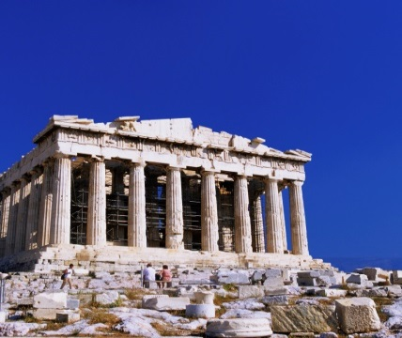

Cultural Dimensions
Optional: Click below if you’d like to explore some examples of possible therapeutic implications to each dimension^{1–3}. ☺
IV. Uncertainty Avoidance
  Discomfort with ambiguity and unusual behaviour and ideas
Long-term orientation:
Might be especially able to grasp the importance of situation and context
May do well with exercises such as genograms and life lines
Indulgent culture:
May wish for rapid results, more short-term goals and reinforcers
Restrained culture:
May take pride in abilities for self-control and restrain emotions
Value patience
High:
Client may be less willing to act outside of social or to try different ways of doing things
May desire more structured approach
Low:
More comfortable with ambiguous communication
May be less accepting of strict rules and boundaries
V. Long-term / Short-term Orientation
  Focus on the long term: saving for the future, taking a historical and contextual perspective
  Focus on the present, absolute truth, and rapid change
Short-term orientation:
May look more towards simpler solutions
Possibly more in touch with themselves in the present i.e., emotional and self-monitoring exercises
VI. Indulgence / Restraint
  Free gratification of basic/natural drives, having fun vs. regulating needs and desires according to strict social norms
¹Hofstede (2011); ²Hofstede, Hofstede, & Minkov (2010); ³The Hofstede Centre (2012a)
Notes:
Uncertainty Avoidance:
High: Client may be less willing to act outside of social or to try different ways of dong things; May desire more structured approach
Low: More comfortable with ambiguous communication; May be less accepting of strict rules and boundaries
Long-term / Short-term Orientation:
Long-term orientation: Might be especially able to grasp the importance of situation and context; May do well with exercises such as genograms and life lines
Short-term orientation: May look more towards simpler solutions; Possibly more in touch with themselves in the present i.e., emotional and self-monitoring exercises
Indulgence / Restraint:
Indulgent culture: May wish for rapid results, more short-term goals and reinforcers
Restrained culture: May take pride in abilities for self-control and restrain emotions; Value patience

Slide 106
Cultural Comparisons
In the next few slides we compare Canada to other nations on the cultural dimensions
What might these dimensions mean about how we’d work with people from these different countries and cultures?

Slide 107
Power Distance
Individualism-Collectivism
Dimension values obtained from Hofstede, Hofstede, & Minkov (2010), and Hofstede & Hofstede (2012)

Slide 108
Masculinity-Femininity
Uncertainty Avoidance
Dimension values obtained from Hofstede, Hofstede, & Minkov (2010), and Hofstede & Hofstede (2012)

Slide 109
Long-Term Orientation
Indulgence-Restraint
Dimension values obtained from Hofstede, Hofstede, & Minkov (2010), and Hofstede & Hofstede (2012)

Slide 110
Cultural Dimension Comparison
Generally, Canadian culture is¹:
  Less accepting of power distance
  Highly individualistic
  Average in masculinity and femininity
  More comfortable with uncertainty
  Has a short-term orientation
  Is indulgent, tolerating eccentric behaviours
I
II
D1
D2
D3
D4
D5
D6
¹Hofstede, Hofstede, & Minkov (2010)

Slide 111
Cultural Dimension Comparison
Therefore, on average, we might expect most clients from other cultures to:
  Prefer a more “expert” working relationship
  Be more contextual, collectivistic, and historic
  Prefer more concrete, less ambiguous strategies
  Put more value in social expectations and self-restraint
Of course we still need to respond to every client’s individual acculturation and values, but cultural dimensions can be a useful tool!

Slide 112
Optional Activity ☺
If you are interested, try comparing two countries or reading more about countries’ cultural profiles on Hofstede’s website here¹
Some of the scores might not match the ones in this presentation exactly because the website does not use the newest 2010 and later data available here²
Which dimension do you think is most influential on counselling preferences?
¹The Hofstede Centre (2012b); ²Hofstede & Hofstede (2012)
Notes:
Url 1: http://geert-hofstede.com/countries.html
Url 2: http://www.geerthofstede.nl/dimension-data-matrix

Slide 113
Integrating Cultural Beliefs Cont’d
Canada was the 4th most individualistic country in the world from a sample of 70+ countries, behind America, Australia, and Britain¹
Asian, African, Hispanic, and Aboriginal Americans all have more group / family centered cultures or live with extended families²
European Americans often see their identity in a less interrelated, contextual way^{3,4}
¹Hofstede, Hofstede, & Minkov (2010); ²Sue & Sue (2008, pp.138–140); ³Hardin (2006); ⁴Harb & Smith (2008)

Slide 114
Integrating Cultural Beliefs Cont’d
As indicated by their high individualism, European-American counsellors can benefit from focusing more on context and social relationships with diverse clients^{1,2}
Western knowledge has a blind spot to collectivist-style interdependence³
I
II
D1
D2
D3
D4
D5
D6
¹Hwang (2009); ²Hays (2009); ³Cheung et al. (2001)

Slide 115
Integrating Cultural Beliefs: Applications
  Reintegrating social context into counselling:
  Increase focus on resolving relational problems¹
  Assess social/ familial/ environmental contributions to illness & wellness²
  Emphasize collaboration over confrontation²
  Be aware that Eastern thinking and problem-solving approaches view solutions as negotiated and dialectical, not analytical, leading to a single correct solution^{3,4}
  Increase client’s ability deal with practical environmental stressors² through practical problem-solving¹
  CBT, SFT, and BT modified to include cultural context are useful for this purpose^{2,5}
¹Hwang (2009); ²Hays (2009); ³Peng & Nisbett (1999); ⁴Nisbett, Peng, Choi, & Norenzayan (2001); ⁵Sue & Sue (2008, p.371)

Slide 116
Integrating Cultural Beliefs: Applications
  Present skills together with cultural context within which they will be effective (e.g., when and where to use assertive communication vs. traditional communication¹)
  Refocus hierarchical, punitive cultural parenting styles on harmonious values of collectivist cultures without criticism³
  Be aware that sharing vs. individual achievement, and non-interference are values of Aboriginal peoples⁴
¹Hays (2009); ²Hwang (2009); ³Sue & Sue (2008, p.371); ³Sue & Sue (2008, p.365); ⁴Sue & Sue (2008, p.350)

Slide 117
Integrating Cultural Beliefs: Applications
  Reframe and normalize familial conflict as acculturation conflict¹
  Educate that Acculturative Family Distancing^{2,3} naturally results due to communicative and value differences and has negative consequences for mental health
  Offer assistance as a cultural broker, facilitating communication and discussion of familial, country-of-origin, and host country cultural standards⁴
  Reframe acculturation as bi-cultural competence
¹Sue & Sue (2008, p.368); ²Hwang & Wood (2009); ³Hwang, Wood, & Fujimoto (2010); ⁴Sue & Sue (2008)

Slide 118
Applications: Aligning with Traditional Forms of Healing¹
  Increase collaboration with cultural healers, doctors, elders, religious figures, and other health practitioners¹
  Distribute materials and raise awareness at strategic locales where clients first seek help²:
    Medical clinics
    Religious groups
    School
    Traditional medicine practitioners
¹Hwang (2006); ²Hwang, Myers, Abe-Kim, & Ting (2008)

Slide 119
Applications: Aligning with Traditional Forms of Healing¹
  Encourage culturally-congruent and inexpensive self-care activities^{1,2}:
    Meditation
    Qi gong
    Tai ji
    Religious ceremonies
    Crafts
    Music
    Massage
    Sweat lodge
    Incense and sweet grass burning
    Smudging
    Outdoor activities¹ (e.g. berry picking³)
¹Hays (2009); ²Hwang (2006); ³Minton & Soule (1990)

Slide 120



Applications: Cultural Strengths Search
Conduct a cultural strengths / assets search¹! Click if you’d like to learn about what you might include in a cultural strengths search ☺
Environmental supports
    Cultural pride
    Religion/spirituality
    Artistic appreciation /ability
    Crafts
    Multilingual skills
    Cultural knowledge
    Practical living skills (i.e. hunting, farming, medicine)
    Beliefs used to cope with prejudice and discrimination
    Extended family
    Traditional celebrations and rituals
    Storytelling activities
    Political / social action groups
    Family pride in accomplishments of its members (e.g. a child's school success¹)
    Space for prayer/meditation
    Available preferred foods
    Access to nature (for gardening, hunting, farming, fishing, spiritual connection)
    Presence of cultural art, videos, and music
    Home furnishings
    Communities that facilitate social interaction (living in a village, reserve, etc¹)
Personal strengths
Interpersonal supports
¹Hays (2009)
Notes:
Personal strengths
Cultural pride
Religion / spirituality
Artistic appreciation / ability
Crafts
Multilingual skills
Cultural knowledge
Practical living skills (i.e. hunting, farming, medicine)
Beliefs used to cope with prejudice and discrimination
Interpersonal supports
Extended family
Traditional celebrations and rituals
Storytelling activities
Political / social action groups
Family pride in accomplishments of its members (e.g. a child's school success¹)
Environmental supports
Space for prayer/meditation
Available preferred foods
Access to nature (for gardening, hunting, farming, fishing, spiritual connection)
Presence of cultural art, videos, and music
Home furnishings
Communities that facilitate social interaction (living in a village, reserve, etc¹)

Slide 121
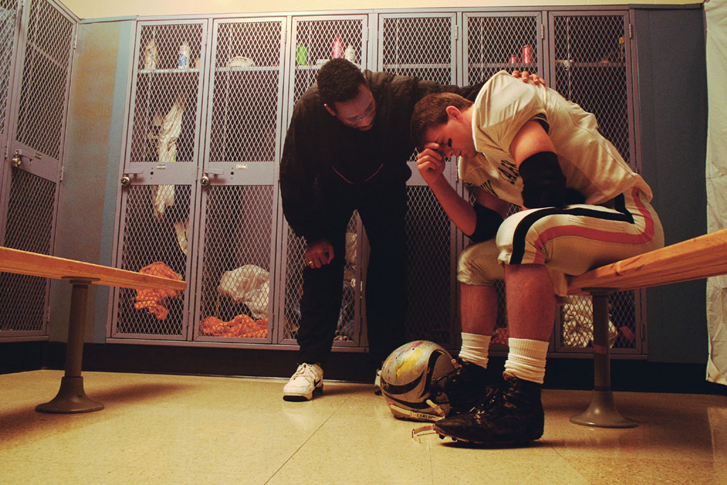
Incorporating Cultural Beliefs: Components
Reducing stigma surrounding help-seeking and the counselling process
I
II
D1
D2
D3
D4
D5
D6

Slide 122
De-stigmatizing Counselling: Applications
  Address community misconceptions about counselling¹
  Increase visibility in the cultural community
  Stress privacy and confidentiality²
  Emphasize counselling as finding solutions rather than admitting failure³
  ¹Hwang, Myers, Abe-Kim, & Ting (2008); ²Sue & Sue (2008, p.372); ³Miller, Yang, & Chen (1997)

Slide 123
De-stigmatizing Counselling: Applications
  In CBT, Decrease emphasis on changing cognitions, but increase positive thinking, problem solving, and behavioural activation¹
  Question the helpfulness rather than rationality of a problematic beliefs, especially when stressors are real (i.e. having children in danger of being taken into custody)²
  ¹Hwang (2009); ²Hays, (2009)

Slide 124
Reflection Question:
Please share an example of another cultural symbol or saying you might adapt to explain a therapeutic concept. ☺
Wow! Thank you for making it this far.
How about another break?
I
II
D1
D2
D3
D4
D5
D6

Slide 125
Domain IV: Client-Therapist Relationship
Please complete self-evaluation sheet domain 3. ☺

Slide 126
Client-Therapist Relationship: Overview
Refers to:
  Improving the client-therapist relationship
  Setting realistic relationship and goal expectations
Benefits^{1,2}:
  Improved working alliance, client comfort
  Increased empathy, greater feeling of social connectedness
  Reduced stigma and anxiety due to realistic expectations
  Reduced anxiety about cultural differences
  Increased feelings of client self-efficacy
  ¹Hwang (2009); ²See also Hwang (2009; 2012)

Slide 127
Client-Therapist Relationship: Components
Developing cultural knowledge and cultural self-awareness
Utilize methods to improve joining
Match some expectations, promote realistic expectations
Ally against racism and prejudice
Strive for achieving a ‘cognitive match’ during discussions

Slide 128
Cultural Knowledge and Self-Awareness: Applications
Read about the cultural background of the client
Inquire directly about cultural values and influences
Expose oneself to different cultures
Explore cultural information such as aggregate personality traits, Hofstede’s cultural dimensions, cultural values and activities
Take part in cultural workshops, coursework, supervision, and consultation, diversify caseload¹
Consider utilizing a White identity model to guide progress towards awareness and anti-racist action
  ¹Arthur & Januszkowski (2001)

Slide 129


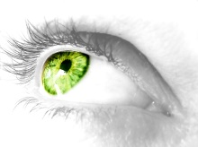
White Identity Development
Naivete
    Formation of non-racist White identity.
    Involves awareness of self as a sociocultural being, appreciation of diversity, and a commitment towards eradication of oppression.
    Sense of security facilitates coping with rejection of being a racially aware White person
    Naive and curious
    about race until socialized with ethnocentric values (by about age 5)
    Consciously or unconsciously accepts European-American cultural superiority.
    May view standards of behaviour and values as universal
    Deny the existence of significant racism
    Expects minorities to assimilate.
    Racism is seen everywhere
    Angry at family, friends, society for participation in racism
    May over-identify with minority groups or strive to protect them in an over-enthused, paternalistic fashion
    Guilt, shame, and anger directed towards White identity
Optional activity:
Click the titles to learn about the 7 stages of development of White racial consciousness (The White Racial Identity Model)¹
    Realization that racism exists (in society, in oneself)
    Reluctance to change because of guilt, anger, feeling powerlessness to change society
Conformity
    Experiences less guilt and anger
    More introspective on meaning of Whiteness, seeking answers
    Feels disconnected from Whites but realizes they can’t fully know the minority experience
    Works actively to change society and oppose racism
    Makes alliances with minority groups and aware Whites
    Resists social pressure for conformity to status-quo
Dissonance
Resistance and immersion
Introspection
Integrative awareness
Commitment to antiracist action
  ¹Sue & Sue (2008, p.277–282)
Notes:
Naivete: Naive and curious about race until socialized with ethnocentric values (by about age 5)
Conformity: Consciously or unconsciously accepts European-American cultural superiority; May view standards of behaviour and values as universal ;Deny the existence of significant racism; Expects minorities to assimilate.
Dissonance: Realization that racism exists (in society, in oneself); Reluctance to change because of guilt, anger, feeling powerlessness to change society
Resistance and immersion: Racism is seen everywhere; Angry at family, friends, society for participation in racism; May over-identify with minority groups or strive to protect them in an over-enthused, paternalistic fashion; Guilt, shame, and anger directed towards White identity
Introspection: Experiences less guilt and anger; More introspective on meaning of Whiteness, seeking answers; Feels disconnected from Whites but realizes they can’t fully know the minority experience
Integrative awareness: Formation of non-racist White identity; Involves awareness of self as a sociocultural being, appreciation of diversity, and a commitment towards eradication of oppression; Sense of security facilitates coping with rejection of being a racially aware White person
Commitment to antiracist action: Works actively to change society and oppose racism; Makes alliances with minority groups and aware Whites; Resists social pressure for conformity to status-quo

Slide 130
Client-Therapist Relationship: Components
Utilize methods to improve joining
I
II
D1
D2
D3
D4
D5
D6

Slide 131
Facilitating Joining: Applications
  Realize building a bond will require more than just elaborate verbal messages¹
  Utilize proper cultural etiquette in initial sessions²:
    Offer tea
    Show concern about client’s physical comfort
    Increase self-disclosure
  Assess family and immigration history as an icebreaker³
  ¹Sue & Sue (2008, p.153); ²Hwang (2009); ³Hwang (2006)

Slide 132
Facilitating Joining: Applications
  Actively provide validation, praise, emotional support, validate difficulty of sharing information¹
  Normalize client feelings of stigma¹
  Convey alignment nonverbally, e.g. moving one’s chair to sit alongside the client while addressing a list of current problems²
  ¹Hwang (2009); ²Thornton as cited in Hays (2009, p.357); ³Hays (2009)

Slide 133
Client-Therapist Relationship: Components
Matching some expectations; promoting realistic expectations

Slide 134
Aligning Expectations: Applications
Explicitly discuss roles and expectations^{1,2}
Appear professional and be more proactive with giving advice³
Be aware of transference of expectations: clients may expect to be treated as they would by doctors, healers, or priests⁴
  ¹Hwang (2006); ²Hwang (2009); ³Hwang (2012); ⁴Sue & Sue (2008, p.147)

Slide 135
Aligning Expectations: Applications
Facilitate development of realistic expectations:
  Emphasize patience¹
  Express that new skills require time to acquire
  Be aware: more severe problems due to delaying treatment may require longer recovery times
  Begin with easier tasks to inspire confidence²
  Share anecdotes or cases that normalize help-seeking, reduce feelings of isolation, normalize initial difficulties³
  ¹Hwang (2006); ²Hays (2009); ³Hwang (2009)

Slide 136
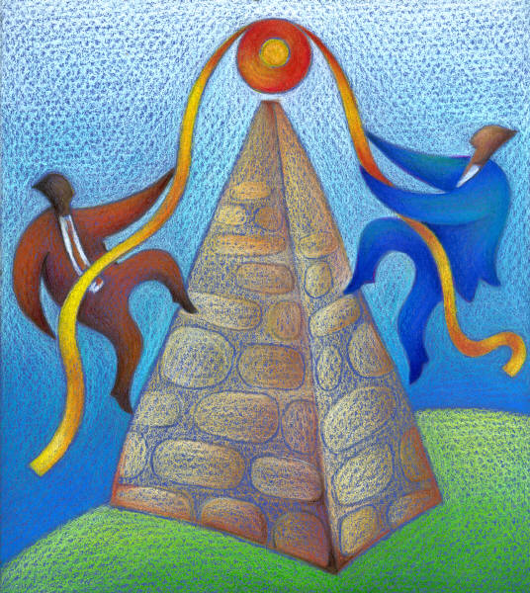
Client-Therapist Relationship: Components
Allying against racism and prejudice
I
II
D1
D2
D3
D4
D5
D6

Slide 137
Allying Against Racism and Prejudice
Racism continues to exist in North America in implicit and covert forms even amongst those who do not believe they hold negative attitudes^{1,2}
It is the counsellor’s responsibility to broach the topic of racism in sessions because clients learn this topic is taboo with most European-Americans³
Doing so may also lead to deeper empathy and a stronger working alliance¹
  ¹Dovidio, Kawakami, Johnson, Johnson, & Howard (1997); ²Dovidio & Gaertner (2004); ³Day-Vines et al. (2007)

Slide 138
Racial Microaggressions
Please click here¹ to learn about racial microaggressions
Optional activity: consider trying an empirically-supported implicit social attitude test here² if you’re interested in learning more about your own implicit attitudes and biases
  ¹Sue (2010); ²Project Implicit (2011)
Notes:
Url 1: http://youtu.be/BJL2P0JsAS4
Url 2: https://implicit.harvard.edu/implicit/

Slide 139
Racial Microaggressions
Receiving subtle, unintentional, negative messages that stereotype or invalidate is a common experience for many ethnic groups^{1–4}
Covert messages leave victim questioning their sensitivity and judgment
Double Bind: victim must cope with unvoiced feelings or voice them and face denial, resentment, & possible escalation of hostilities
Awareness of the possibility of discrimination having occurred provokes negative emotional consequences⁴
  ¹Constantine, Smith, Redington, & Owens (2008); ²Sue, Bucceri, Lin, Nadal, & Torino (2009);
  ³Sue, Lin, Torino, Capodilupo, & Rivera. (2009); ⁴Wang, Leu, & Shoda (2011)

Slide 140


Racial Microaggressions
Please click to explore 3 types of Microaggressions!¹
Microassaults
    Similar to old-fashioned, overt racism, but typically happens in private, when the perpetrator loses control, or is within an anonymous or private environment
    Examples: Mel Gibson’s anti-Semitic remarks when arrested for driving while intoxicated. Serving Black patrons in a restaurant last.²
    “Represent subtle snubs, frequently unknown to the perpetrator, but clearly convey a hidden insulting message to the recipient”³
    Examples: Asking someone where they are from or complementing them on their English simply because they are not Caucasian (message received: your group is un-Canadian)
    Deny perpetrator’s bias
    Dismiss the reality of and psychological experience of racism
    Examples: Accusing the victim of oversensitivity, proclaiming one has friends of colour and is therefore immune to racism¹
Microinsults
Microinvalidations
  ¹Sue, Bucceri, Lin, Nadal, & Torinio (2007); ²Sue & Sue (2008, p.111); ³Sue, Bucceri, Lin, Nadal, & Torinio (2007, p.274);
Notes:
Microassaults: Similar to old-fashioned, overt racism, but typically happens in private, when the perpetrator loses control, or is within an anonymous or private environment; Examples: Mel Gibson’s anti-Semitic remarks when arrested for driving while intoxicated. Serving Black patrons in a restaurant last.²
Microinsults: “Represent subtle snubs, frequently unknown to the perpetrator, but clearly convey a hidden insulting message to the recipient”³; Examples: Asking someone where they are from or complementing them on their English simply because they are not Caucasian (message received: your group is un-Canadian)
Microinvalidations: Deny perpetrator’s bias; Dismiss the reality of and psychological experience of racism; Examples: Accusing the victim of oversensitivity, proclaiming one has friends of colour and is therefore immune to racism¹

Slide 141
Allying Against Racism and Prejudice: Applications
  Actively broach the topic of race and racism in sessions¹
  Anticipate mistrust²
  Strongly consider validating feelings of victimization even when they might be part of client symptoms^{1,3}
  Validate racial microaggressions as real and hurtful
  ¹Day-Vines et al. (2007); ²Hays (2009)

Slide 142
Client-Therapist Relationship: Components
Strive for achieving a ‘cognitive match’ during discussions

Slide 143
Cognitive Matching
Maintaining a “cognitive match” -agreement on problem conceptualization, treatment, and goals, is tied to better outcomes, and smoother, deeper, more positive sessions¹
  Cultural cognitive matching involves matching therapeutic discussions and interventions to individual, sociocultural, or universal levels according to client problem conceptualization²
  ¹Zane et al. (2005); ²Leong (2007)

Slide 144
Cognitive Matching: Applications
Avoid challenging important cultural beliefs unless this is an important goal for the client¹
Match therapeutic discussions and interventions to individual, sociocultural, or universal levels²:
  Example:
    A client experiencing discomfort after a negative social interaction may interpret it as because of systemic racism, personal insecurity, or a universal experience of pain due to rejection
    Practitioner thoroughly explores the problem from the client’s explanatory level before discussing it from other angles
  ¹Hays (2009); ²Leong (2007)

Slide 145
Reflection Questions:
Imagine a client described to you not getting a return phone call after a job interview. What words would you use to broach the topic of racism in a session?
What exploration question might you use next?
Please fill out self-evaluation sheet domain 4. ☺
I
II
D1
D2
D3
D4
D5
D6

Slide 146
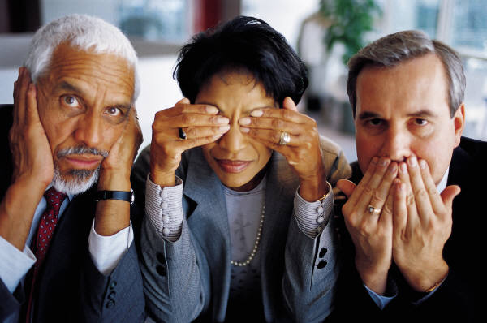
Domain V: Cultural differences in Expression and Communication

Slide 147
Cultural Differences in Communication: Overview
Refers to:
  Understanding and overcoming differences in communication, including different ways of expressing distress
Benefits^{1,2}:
  Reduces misunderstandings and miscommunications
  Reduces stigma
  Improves treatment outcomes
  Increases comfort despite foreign communication styles
  ¹Hwang (2006); ²Hwang (2009)

Slide 148

Cultural Differences in Communication: Components
Understand and respond to differences in communication
Adapt practice to somatization and other cultural expressions of distress

Slide 149
Cultural Differences in Communication
Effective therapy “depends on the therapist and client being able to send and receive both verbal and nonverbal messages accurately and appropriately”¹
Understanding communication styles includes awareness of factors such as body language, eye contact, personal space, and high vs. low context communication (direct vs. indirect communication²
  ¹Sue & Sue (2008, p.160); ²Sue (1990)

Slide 150
Comparison of Communicative Styles¹
First Nations | Asian Americans and Hispanics | European Americans | African Americans
Speak softly & slower | Speak softly | Increase speed / volume to direct listener | Speak with affect
Indirect eye contact | Polite to avoid eye contact with high-status persons | Eye contact when listening | Direct eye contact when speaking, less eye contact when listening
Interject less, few encouragers | Interject less, few encouragers | Head nods, nonverbal markers | Interruptive turn taking
Allow silence before responding | Mild delay before responding | Quick responding | Quickest responding
Low-keyed, indirect expression | Low-keyed, indirect | Objective, task-oriented | Affective, emotional, interpersonal
  ¹Sue & Sue (2008, p.176)

Slide 151
Reflection Questions:
Would you attempt to match a diverse client’s communicative style in terms of speed, tone, expressed emotion or other characteristics?
Why or why not? or To what degree might you do so?
I
II
D1
D2
D3
D4
D5
D6

Slide 152
High and Low Context Communication
High Context vs. Low Context Communication¹ :
  Low context communication:
    Typical of European-American culture
    Speaking directly and saying what one means
  High context communication:
    Shared by Asians, Hispanics, First Nations, some African-Americans¹
    Conveys more information through how something is said than what is said
    Greater importance on situation, tone, and body language
  ¹Sue & Sue (2008)

Slide 153
Cultural Differences in Communication: Understanding Communicative Differences
High Context Examples¹:
  European culture: “No” = no
  Filipino culture: Hesitant yes = no
  Arab culture: “No” during business = ok to keep bargaining, until “no” is stressed very strongly
  Asian & Arab cultures: Invitations must be extended and refused multiple times before they are accepted
  ¹Sue & Sue (2008)

Slide 154
Uncertainty Reduction
Uncertainty reduction theory describes the motivation to reduce uncertainty in interactions with strangers¹
A major goal in initial intercultural interactions is to reduce ambiguity between participants, so more interrogation, self-disclosure, and nonverbal affiliative expressions are used^{2–4}
  ¹Berger & Calabrese (1975); ²Gudykunst & Nishida (1984); ³Gudykunst, Sodentani, & Sonoda (1987);
  ⁴Gudykunst, Yang, & Nishida (1985)

Slide 155
Uncertainty Reduction
Non-verbal affiliative expressions:
    Are non-verbals that convey a feeling of invitation and social connectedness¹:
      Gaze
      Smile
      Touch
      Inviting facial expressions
    These expressions are also conveyed online through emoticons, smileys, and text formatting²
  ¹Yang (2007); ²Curtis (2009)

Slide 156
( ͡° ͜ʖ ͡°)﻿ ˁ˚ᴥ˚ˀ ✌(◕‿-)¹
-`ღ´-
Thank you for persevering with this presentation so far! You’re almost done.
I
II
D1
D2
D3
D4
D5
D6
  ¹Kula One (n.d.)

Slide 157
Other Communicative Differences¹
  A smile can indicate discomfort or embarrassment in Asian cultures, may be misread as smugness during conflict
  Silence can indicate respect, privacy, or agreement in different cultures
  Some Arabic-speaking cultures like to be bathed in sound and politely ‘share’ it with their neighbours
  Aboriginal culture is a storytelling culture that emphasizes learning by listening
  Asian, African, Hispanic, and Arab Americans all prefer a closer interpersonal space than European Americans^{1–3}
  ¹Sue & Sue (2008); ²See also Sue (1990); ³Rivera & Rogers-Adkinson (1997)

Slide 158
Communication: Applications
Consider using silence to demonstrate understanding in initial sessions¹
Avoid misinterpreting normal low-key, indirect communicative behaviour as evidence of passivity, avoidance, or shyness² especially with Asian, Aboriginal, and Hispanic clients
Allow Aboriginal persons ample time to finish speaking³
Be aware of differences in meaning of smiles, silence, eye contact
  ¹Hays (2009); ²Hwang (2006); ³Sue & Sue (2008, p.357)

Slide 159
Communication: Applications
Increase self-disclosure, invitational body language, and allow questions¹
Employ visuals, translators, supportive friends or family members, multilingual dictionaries²
Be aware of ethical limitations of child translators¹
Apologize for the limitations of one’s cultural helping style but express a willingness to understand the client and their situation, this is enough for many clients³
  ¹Sue & Sue (2008); ²Hwang & Wood (2007); ³Sue & Sue (2008, pp.180–181)

Slide 160
Communication: Applications
Utilize homework evaluation forms to facilitate more direct feedback¹
Consider exit/feedback slips like the multilingual and free Session Rating Scale² and Outcome Rating Scale³
Awareness of interpersonal distance: counsellor may come off as cold if draws back from a client without discussion of its cultural meaning⁴
  ¹Foo & Kazantzis (2007); ²Miller, Duncan, Brown, Sparks, & Claud (2003); ³Campbell & Hemsley (2009); ⁴Sue (1990)

Slide 161

Cultural Differences in Communication: Components
Adapting practice to somatization and other cultural expressions of distress
I
II
D1
D2
D3
D4
D5
D6

Slide 162
Cultural Expressions of Distress
Understanding cultural communication of distress is an essential component of cross-cultural counselling¹
Somatization = expressing emotional distress through physical symptoms
Is “the most common clinical expression of emotional distress worldwide”²
Is ubiquitous, occurring across Western and non-Western countries²
  ¹Hwang (2006); ²Kiramayer & Young (1998, p.420)

Slide 163
Cultural Expressions of Distress
Study: 88% of depressed Chinese reported only somatic symptoms, but 20% of Western clients did the same¹
Similarly, somatization scores for depressed African American and Latina women were 70% higher than European-American women, but were significant, for all groups²
For some clients, this may be a negotiative tactic, (easier to talk about than mental illness) i.e. Asian clients are able to discuss emotions when asked or when the working alliance is strong^{1–3}
But can also be due to a greater belief in mind-body unity^{6–7}
  ¹Kleinman (1977); ²Myers et al. (2002) ³Cheung (1982); ⁴Cheung & Lau (1982); ⁵Parker, Gladstone, & Chee (2001); ⁶ Hwang, Wood, Lin, & Cheung (2006); ⁷Lee (2001)

Slide 164





Cultural Expressions of Distress
Cultural physical symptoms may include¹:
Worms in the head
Crawling ants under skin
Headaches
Burning hands and feet
Chest pains
Gastrointestinal problems
Heart palpitations
Bodily pain
  ¹Hwang (2006)

Slide 165
Cultural Expressions of Distress: Applications
Focus part of early assessment on physical symptoms¹
Inquire about psychosocial symptoms indirectly: “Dealing with headaches and dizziness can be quite troublesome; how are these affecting your mood, relationships, etc.?”²
Help clients differentiate between thoughts and feelings during treatment³
Be patient and clients will likely share emotional distress after a strong relationship is built
No need to withhold/hide diagnosis –diagnose collaboratively⁴
  ¹Hwang (2006); ²(Sue & Sue, 2008, p.366); ³Hwang (2009); ⁴Hwang(2012)

Slide 166
Cultural Expressions of Distress: Applications
Non-stigmitizing procedure for diagnosing depression¹:
  Separate physical and mental symptoms into checklists, consider expanding checklist with additional cultural somatic symptoms
  Introduce the checklist as a list of problems clients often struggle with, and ask if the client experiences similar problems
  Tell the client that when people have checked a significant number of those symptoms, it's called major depression
  Ask if they think they have major depression
This procedure resulted in clients actively accepting and using the diagnostic label!
  ¹Hwang (2012, pp.190,191)

Slide 167
Reflection Question:
If a client reports somatic symptoms, but you suspect they are holding back cognitive and emotional information until they feel more comfortable with you, how might you present or frame an initial intervention to him or her?
Please complete evaluation sheet domain 5. ☺
I
II
D1
D2
D3
D4
D5
D6

Slide 168

Domain VI: Cultural Issues of Salience

Slide 169
Cultural Issues of Salience: Overview
Refers to¹:
  Addressing other cultural issues of salience to the client
  Awareness of unique issues for a client’s ethnic group
Benefits^{1,2}:
  Client feels more understood and satisfied
  Avoid overlooking key issues
  Ensures treatment aligns with client priorities
  ¹Hwang (2006); ²(Hwang, 2012)

Slide 170
Cultural Issues of Salience: Components
Issues will be different for every culture and client
This challenges practitioners to take initiative to learn about specific cultural groups and to conduct holistic and individualized assessment
Exploring these issues for each cultural group is beyond the scope of this presentation, but a few examples will be provided for what to look for

Slide 171
Cultural Issues of Salience: Examples
Suicide in Aboriginal youth is 5–6x higher than the Canadian youth average¹
Possible interventions¹:
  Community-based suicide prevention programs
  Building helper connections with young people
  Address related issues of substance abuse, mood disorders, and conduct/ antisocial disorders
  Cultural reconnection activities - this is a healing intervention in and of itself²
  Promote cultural continuity in Aboriginal communities, as this is a strong protective factor against suicide³
  ¹Aboriginal Healing Foundation (2007); ²Stewart (2008); ³Chandler & Lalonde (1998)

Slide 172
Cultural Issues of Salience: Examples
African Americans:
Face systemic barriers and prejudice¹
Additional challenges due to lack of financial resources, educational barriers
Asian Peoples:
High somatization rates²
Deep stigma involving mental health help-seeking
Family pressure for academic success¹
Arabic-Speaking Groups:
Fear of reduced marriageability resulting from help seeking
  ¹ Sue & Sue (2008); ²Hwang (2006); ³Youssef & Deane (2006)

Slide 173
Taking an Expanded Approach
Culturally diverse clients often face practical challenges that may take precedence over psychological growth¹
Barriers to counselling: language, finances, transportation, and awareness of services²
Pressing needs: affordable housing, employment, social contact, familiarity with Western norms, social support¹
Therefore counsellors are challenged to expand beyond traditional ways of helping^{3,4}
  ¹George (2002); ²Kung (2004); ³Atkinson, Kim & Caldwell (1998); ⁴Atkinson, Thompson, & Grant (1993)

Slide 174
Taking an Expanded Approach
Hays (2009) suggests that practitioners identify environmental problems and teach behavioural skills to change the environment while also working on cognitive skills
For example: Working on Western social interaction skills, educational skills, or social behavioural activation activities with a depressed international student together with restructuring cognitions
I
II
D1
D2
D3
D4
D5
D6

Slide 175
3 Dimensional Model of Multicultural Counselling¹
Practitioners may need to take on new roles in multicultural counselling¹:
  An advocate helping clients to access resources and be understood by others
  A cultural healing / cultural strength facilitator
  A consultant, training clients to respond to discrimination and barriers
  A change agent who lobbies for societal change
  ¹Atkinson, Thompson, & Grant (1993)

Slide 176
3 Dimensional Model of Multicultural Counselling¹
Locus
of Problem
External
Advisor
Consultant
Internal
Counsellor
Facilitator of Indigenous Support System
Prevention
Goal of Helping
Change Agent
Advocate
Remediation
Facilitator of Indigenous Healing Methods
Psychotherapist
Low
Acculturation
High
  ¹Atkinson, Thompson, & Grant (1993)

Slide 177
Collaborative Therapeutic Adaptation
Therapeutic adaptation frameworks are usually top-down (improvements generated by theory & research)¹
Working with the community to design a program is another option (bottom-up)
This is an increasing trend with two new frameworks recently being applied for this purpose
  ¹Hwang (2009)

Slide 178
Collaborative Therapeutic Adaptation
Collaborating with stakeholders can lead to new information and strategies^{1,2} while empowering the community to participate in designing its own care
The Formative Method for Adapting Psychotherapy (FMAP¹) is a five-phase framework designed for use with the PAMF to combine top-down and bottom-up processes
I
II
D1
D2
D3
D4
D5
D6
  ¹Hwang (2009); ²(Hwang, 2012)

Slide 179
The FMAP¹
Phase 1
Phase 2
Phase 3
Phase 4
Phase 5
Generating Knowledge and Collaborating with Stakeholders
Integrating Generated Information with Theory and Empirical and Clinical Knowledge
Review of Culturally Adapted Clinical Intervention by Stakeholders and Further Revision
Testing the Culturally Adapted Intervention
Synthesizing Stakeholder Feedback and Finalizing the Intervention
  ¹Hwang (2009)

Slide 180
Collaborative Therapeutic Adaptation
More information on this bottom-up framework is available in Hwang (2009) or Hwang (2012)
For those who prefer the Ecological Validity Model for adapting psychotherapy, the Cultural Adaptation Process Model¹ is a three-phase framework similar to the FMAP, designed for that model
Please complete self-evaluation sheet domain 6. ☺
  ¹Domenech-Rodriguez & Weiling (2004)

Slide 181

Workshop Summary
Through the PAMF framework we learned about respecting the complexity of clients, welcoming and orienting them to psychotherapy, and integrating cultural beliefs into our practice. We also discussed how to join with others across cultures, aligning expectations, and overcoming communicative barriers. Finally we explored the importance of adopting an expanded helping role and the challenge of becoming more informed about others.
I hope that this workshop equips you with some more tools you can use to build richer working relationships with your clients and contribute more deeply to Canada’s multicultural communities.
I wish you the best on the rest of your journey!
    -Tom Rapacki
Congratulations!

Slide 182
Thank you for reading!
Your feedback on this learning experience is important to me, and helps to improve this presentation for future workshops. I invite you to fill out one of the evaluation forms included in this package.
I would also like to hear about your experience in putting this information into practice! Please feel welcome to contact me about this project!

Slide 183
References
Aboriginal Healing Foundation. (2007). Suicide among Aboriginal people in Canada. Ottawa, ON: Author.
Absolon, K. (2010). Indigenous wholistic theory: A knowledge set for practice. First Peoples Child & Family Review, 5(2), 74–87.
Al-Krenawi, A., & Graham, J. R. (2000). Culturally sensitive social work practice with Arab clients in mental health settings. Health Social Work, 25(1), 9–22. doi:10.1093/hsw/25.1.9
American Psychological Association. (2002). Guidelines on multicultural education, training, research, practice, and organizational change for psychologists. Washington, DC: Author.
Arthur, N., & Collins, S. (2010). Culture-infused counselling: A model for developing multicultural competence. Counselling Psychology Quarterly, 23, 217–233. doi:10.1080/09515071003798212
Arthur, N., & Januszkowski, T. (2001). The multicultural counselling competencies of Canadian counsellors. Canadian Journal of Counselling, 35, 36–48.
Atkinson, D. R., Kim, B. S. K., & Caldwell, R. (1998). Ratings of helper roles by multicultural psychologists and Asian American students: Initial support for the three-dimensional model of multicultural counseling. Journal of Counseling Psychology, 45, 414–423.
Atkinson, D. R., Thompson, C. E., & Grant, S. K. (1993). A three-dimensional model for counseling racial/ethnic minorities. The Counseling Psychologist, 21, 257–277. doi:10.1177/0011000093212010
Benish, S. G., Quintana, S., & Wampold, B. E. (2011). Culturally adapted psychotherapy and the legitimacy of myth: A direct-comparison meta-analysis. Journal of Counseling Psychology, 58, 279–289. doi:10.1037/a0023626
Berger, C. R., & Calabrese, R. J. (1975). Some explorations in initial interaction and beyond: Toward a developmental theory of interpersonal communication. Human communication research, 1, 99–112.
Bernal, G., Bonilla, J., & Bellido, C. (1995). Ecological validity and cultural sensitivity for outcome research: Issues for cultural adaptation and development of psychosocial treatments with Hispanics. Journal of Abnormal Child Psychology, 23, 67–82.
Brouillet, F., Marshall, C. R., & Andrews, T. E. (1987). Teaching and learning in the cognitive domain: A Review of the Literature. U.S. Department of Education, Office of Educational Research and Improvement.
California State Department of Education. (1982). American Indian education handbook. Sacramento, CA: California State Department of Education, American Indian Education Unit.
Campbell, A., & Hemsley, S. (2009). Outcome rating scale and session rating scale in psychological practice: Clinical utility of ultra-brief measures. Clinical Psychologist, 13, 1–9. doi:10.1080/13284200802676391
Canadian Psychological Association. (CPA). (2000). Canadian code of ethics for psychologists (3rd ed.). Ottawa, ON, Canada: Author.
Canadian Psychological Association. (CPA). (2001). Guidelines for non-discriminatory practice. Retrieved from: www.cpa.ca/cpasite/userfiles/Documents/publications/NonDiscPractrev%20cpa.pdf
Chandler, M. J., & Lalonde, C. (1998). Cultural continuity as a hedge against suicide in Canada's First Nations. Transcultural Psychiatry, 35, 191–219.
Chen, S. X., Chan, W., Bond, M. H., & Stewart, S. M. (2006). The effects of self-efficacy and relationship harmony on depression across cultures: Applying level-oriented and structure-oriented analyses. Journal of Cross-Cultural Psychology, 37, 643–658. doi:10.1177/0022022106292075
Cheung, F. M. (1982). Somatization among Chinese: A critique. Bulletin of the Hong Kong Psychological Society, 8, 27–35.
Cheung, F. M. (2007). Indigenous personality correlates from the CPAI-2 profiles of Chinese psychiatric patients. World Cultural Psychiatry Research Review, 2, 114–117.

Slide 184
References cont’d
Cheung, F. M., Cheung, S. F., Wada, S., & Zhang, J. (2003). Indigenous measures of personality assessment in Asian countries: A review. Psychological Assessment, 15, 280–289.
Cheung, F. M., Kwong, J. Y. Y., & Zhang, J. (2003). Clinical validation of the Chinese Personality Assessment Inventory (CPAI). Psychological Assessment, 15, 89–100.
Cheung, F. M., & Lau, B. W. (1982). Situational variations of help-seeking behavior among Chinese patients. Comprehensive Psychiatry, 23, 252–262.
Cheung, F. M., Leung, K., Song, W. Z., & Zhang, J. X. (2001). The Cross-Cultural (Chinese) Personality Assessment Inventory-2 (CPAI-2). (Available from F. M. Cheung, Department of Psychology, The Chinese University of Hong Kong, Hong Kong SAR.)
Cheung, F. M., Leung, K., Zhang, J. X., Sun, H. F., Gan, Y. Q., Song, W. Z., & Xie, D. (2001). Indigenous Chinese personality constructs: Is the Five Factor Model complete? Journal of Cross-Cultural Psychology, 32, 407–433.
Church, T. A. (2000). Culture and personality: Towards an integrated cultural trait psychology. Journal of Personality, 68, 651–703.
Collins, S., & Arthur, N. (2010). Culture-infused counselling: A model for developing multicultural competence. Counselling Psychology Quarterly, 23, 217–233. doi:10.1080/09515071003798212
Constantine, M., Smith, L., Redington, R. M., & Owens, D. (2008). Racial microaggressions against Black counseling and counseling psychology faculty: A central challenge in the multicultural counseling movement. Journal of Counseling and Development, 86, 348–355. doi: 10.1002/j.1556-6678.2008.tb00519.x
Curtis, J. (2009). Use of uncertainty reduction theory to examine emoticons and other chat room tools’ facilitation of affiliative nonverbal communication. Unpublished master’s thesis, The State University of New York; Potsdam, New York. Retrieved from: http://dspace.sunyconnect.suny.edu/handle/1951/44972
Day-Vines, N., Wood, S., Grothaus, T., Craigen, L., Holman, A., Dotson-Blake, K., & Douglass, M. (2007). Broaching the subjects of race, ethnicity, and culture during the counseling process. Journal of Counseling and Development, 85, 402–410. doi:10.1002/j.1556-6678.2007.tb00608.x
Diener, E., & Diener, M. (1995). Cross-cultural correlates of life satisfaction and self-esteem. Journal of Personality and Social Psychology, 68, 653–663.
Domenech-Rodriguez, M. M. (2008, December). Outcomes of a RCT of PMTO for Spanish-speaking Latino parents: Behavioral observations of parenting practices. Paper presented at the National Institute of Health Summit: The Science of Eliminating Health Disparities, Washington, DC.
Domenech-Rodriguez, M. M., & Weiling, E. (2004). Developing culturally appropriate, evidence-based treatments for interventions with ethnic minority populations. In M. Rastogin & E. Weiling (Eds.), Voices of color: First person accounts of ethnic minority therapists. (pp. 313–333). Thousand Oaks: Sage Publications.
Dovidio, J. F., & Gaertner, S. L. (2004). Aversive racism. In M. P. Zanna (Ed.), Advances in experimental social psychology (pp. 1–52). San Diego, CA: Academic Press.
Dovidio, J. F., Kawakami, K., Johnson, C., Johnson, B., & Howard, A. (1997). The nature of prejudice: Automatic and controlled processes. Journal of Experimental Social Psychology, 33, 510–540.
Flannery, W., Reise, S. P., & Yu, J. (2001). An empirical comparison of acculturation models. Personality and Social Psychology Bulletin, 27, 1035–1045.
Foo, K. H., & Kazantzis, N. (2007). Integrating homework assignments based on culture: Working with Chinese patients. Cognitive and Behavioral Practice, 14, 333–340. doi:10.1016/j.cbpra.2006.08.005

Slide 185
References cont’d
Frey, L. L., & Roysircar, G. (2006). South Asian and East Asian international students' perceived prejudice, acculturation, and frequency of help resource utilization. Journal of Multicultural Counseling and Development, 34, 208–222. doi:10.1002/j.2161-1912.2006.tb00040.x
Gallardo, M., Johnson, J., Parham, T., & Carter. J. (2007). Ethics and multiculturalism: Advancing cultural and clinical responsiveness. American Psychologist, 8(11), 425–435. doi:10.1037/a0016871
George, U. (2002). A needs-based model for settlement service delivery for newcomers to Canada. International Social Work, 45, 465–480. doi:10.1177/00208728020450040501
Goldberg, L. R. (1999). A broad-bandwidth, public domain, personality inventory measuring the lower-level facets of several five-factor models. Personality psychology in Europe, 7, 7–28. Retrieved from: http://ipip.ori.org/newBroadbandText.htm
Gonzalez-Prendes, A. A., Hindo, C., & Pardo, Y. F. (2011). Cultural values integration in cognitive-behavioral therapy for a Latino with depression. Clinical Case Studies, 10, 376–394. doi:10.1177/1534650111427075
Griner, D., & Smith, T. B. (2006). Culturally adapted mental health intervention: A meta-analytic review. Psychotherapy: Theory, Research, Practice, Training, 43, 531–548. doi:10.1037/0033-3204.43.4.531
Gudykunst, W. B., & Nishida, T. (1984). Individual and cultural influences on uncertainty reduction. Communication Monographs, 51, 23–36. doi:10.1080/03637758409390181
Gudykunst, W. B., Sodetani, L. L., & Sonoda, K. T. (1987). Uncertainty reduction in Japanese-American/Caucasian relationships in Hawaii. Western Journal of Speech Communication, 51, 256–278. doi:10.1080/10570318709374271
Gudykunst, W. B., Yang, S.-M., & Nishida, T. (1985). A cross-cultural test of uncertainty reduction theory: Comparisons of acquaintances, friends, and dating relationships in Japan, Korea, and the United Sates. Human Communication Research, 11, 407–454. doi:10.1111/j.1468-2958.1985.tb00054.x
Harb, C., & Smith, P. (2008). Self-construals across cultures: Beyond independence– interdependence. Journal of Cross-Cultural Psychology, 39, 178–197. doi:10.1177/0022022107313861
Hardin, E. (2006). Convergent evidence for the multidimensionality of self-construal. Journal of Cross-Cultural Psychology, 37, 516–521. doi:10.1177/0022022106290475
Hays, P. A. (2009). Integrating evidence-based practice, cognitive–behavior therapy, and multicultural therapy: Ten steps for culturally competent practice. Professional Psychology: Research and Practice, 40, 354–360. doi:10.1037/a0016250
The Hofstede Centre (2012a). Dimensions. Retrieved from: http://geert-hofstede.com/dimensions.html
The Hofstede Centre (2012b). The Hofstede Centre. Retrieved from: http://geert-hofstede.com/index.php
Hofstede, G. (2011). Dimensionalizing cultures: The Hofstede model in context. Online Readings in Psychology and Culture, 2(1). doi:10.9707/2307-0919.1014
Hofstede, G., & Hofstede, G .J. (2012). Dimension Data Matrix. Retrieved from: http://www.geerthofstede.nl/dimension-data-matrix
Hofstede, G., Hofstede, G. J., & Minkov, M. (2010). Cultures and organizations: Software of the mind, 3rd ed. New York: McGraw-Hill.
Huey, S. J., & Polo, A. J. (2008). Evidence-based psychosocial treatments for ethnic minority youth. Journal of Clinical Child and Adolescent Psychology, 37, 262–301. doi:10.1080/15374410701820174
Hwang, W. (2006). The psychotherapy adaptation and modification framework: Application to Asian Americans. American Psychologist, 61, 702–715. doi:10.1037/0003-066X.61.7.702
Hwang, W. (2009). The formative method for adapting psychotherapy (FMAP): A community-based developmental approach to culturally adapting therapy. Professional Psychology: Research and Practice, 40, 369–377. doi:0.1037/a0016240

Slide 186
References cont’d
Hwang, W. (2011). Cultural adaptations: A complex interplay between clinical and cultural issues. Clinical Psychology: Science and Practice, 18, 238–241. doi:10.1111/j.1468-2850.2011.01255.x
Hwang, W. (2012). Integrating top-down and bottom-up approaches to culturally adapting psychotherapy: Application to Chinese Americans. In G. Bernal & M. M. Domenech Rodriguez (Eds.), Cultural Adaptations: Tools for Evidence-Based Practice with Diverse Populations (pp. 179–199). American Psychological Association Press.
Hwang, W., Myers, H. F., Abe-Kim, J., & Ting, J. Y. (2008). A conceptual paradigm for understanding culture's impact on mental health: The cultural influences on mental health (CIMH) model. Clinical Psychology Review, 28, 211–227. doi:10.1016/j.cpr.2007.05.001
Hwang, W., & Wood, J. J. (2007). Being culturally sensitive is not the same as being culturally competent. Pragmatic Case Studies in Psychotherapy, 3(3), 44–50.
Hwang, W., & Wood, J. J. (2009). Acculturative family distancing: Links with self-reported symptomatology among Asian Americans and Latinos. Child psychiatry and human development, 40, 123–138. doi:10.1007/s10578-008-0115-8
Hwang, W., Wood, J. J., & Fujimoto, K. (2010). Acculturative family distancing (AFD) and depression in Chinese American families. Journal of consulting and clinical psychology, 78, 655-667. doi:10.1037/a0020542.
Hwang, W., Wood, J. J., Lin, K., & Cheung, F. (2006). Cognitive-behavioral therapy with Chinese Americans: Research, theory, and clinical practice. Cognitive and Behavioral Practice, 13, 293–303. doi:10.1016/j.cbpra.2006.04.010
Johnson, J. A. (2001). The IPIP-NEO (International Personality Item Pool Representation of the NEO PI-R™). Retrieved from: http://www.personal.psu.edu/faculty/j/5/j5j/IPIP/
Keefee, S. E. (1982). Help-seeking behavior among foreign-born and native-born Mexican Americans. Social Science & Medicine, 16, 1467–1472. doi:10.1016/0277-9536(82)90061-2
Kim, B. S. K., Atkinson, D. R., & Yang, P. H. (1999). The Asian Values Scale: Development, factor analysis, validation, and reliability. Journal of Counseling Psychology, 46, 342–352.
Kim, B. S. K., Li, L. C., & Liang, C. T. H. (2002). Effects of Asian American client adherence to Asian cultural values, session goal, and counselor emphasis of client expression on career counselling process. Journal of Counseling Psychology, 49, 342–354. doi:10.1037/0022-0167.49.3.342
Kirmayer, L. J., du Fort, G. G., Young, A., Weinfeld, M., & Lasry, J. C. (1996). Pathways and barriers to mental health care in an urban multicultural milieu: An epidemiological and ethnographic study. Culture and Mental Health Research Unit, McGill University, Montreal. Retrieved from: https://www.mcgill.ca/files/tcpsych/Report6.pdf
Kirmayer, L. J., & Young, A. (1998). Culture and somatization: Clinical, epidemiological, and ethnographic perspectives. Psychosomatic Medicine, 60, 420–430.
Kleinman, A. M. (1977). Depression, somatization and the “new cross-cultural psychiatry”. Social Science & Medicine, 11, 3–9.
Kleinman, A., Eisenberg, L., & Good, B. (2006). Culture, illness, and care: Clinical lessons from anthropologic and cross-cultural research. FOCUS: The Journal of Lifelong Learning in Psychiatry, 4, 140–149.
Kosmitzki, C. (1996). The reaffirmation of cultural identity in cross-cultural encounters. Personality and Social Psychology, 86, 796–813.
Kula One (n.d.) 1 line art: ASCII art in one line. Retrieved from: http://1lineart.kulaone.com/

Slide 187
References cont’d
Kung, W. (2004). Cultural and practical barriers to seeking mental health treatment for Chinese Americans. Journal of Community Psychology, 32, 27–43. doi:10.1002/jcop.10077
LaFromboise, T. D., Trimble, J., & Mohatt, G. (1990). Counseling intervention and American Indian tradition: An integrative approach. Counseling Psychologist, 18, 628–654.
Lee, S. (2001). From diversity to unity: The classification of mental disorders in 21st century China. Cultural Psychiatry: International Perspectives, 24, 421–431.
Lefley, H., Bestman, E. (1991). Public-academic linkages for culturally sensitive community mental health. Community Mental Health Journal, 27, 473–491.
Leong, F. T. L. (1996). Towards an integrative model for cross-cultural counseling and psychotherapy. Applied and Preventive Psychology, 5, 189–209.
Leong, F. T. L. (2007). Cultural accommodation as method and metaphor. American Psychologist, 14, 915–922. doi:10.1037/0003-066X.62.8.916
Lin, E. J. L., & Church, A. T. (2004). Are indigenous Chinese personality dimensions culture-specific? An investigation of the Chinese Personality Assessment Inventory in Chinese American and European American samples. Journal of Cross-Cultural Psychology, 35, 586–605. doi:10.1177/0022022104268390
Li, L. C., & Kim, B. S. K. (2004). Effects of counseling style and client adherence to Asian cultural values on counseling process with Asian American college students. Journal of Counseling Psychology, 51, 158–167. doi:10.1037/0022-0167.51.2.158
Matos, M., Torres, R., Santiago, R., Jurado, M., & Rodriguez, I. (2006). Adaptation of parent-child interaction therapy for Puerto Rican families: A preliminary study. Family Process, 45, 205–222. doi:10.1111/j.1545-5300.2006.00091.x
Matsumoto, D., & Juang, L. (2008). Culture & Psychology, 4th ed. Belmont, CA: Wadsworth.
Matsumoto, D., Weissman, M., Preston, K., Brown, B., & Kupperbusch, C. (1997). Context-specific measurement of individualism-collectivism on the individual level: The IC interpersonal Assessment Inventory (ICIAI). Journal of Cross-Cultural Psychology, 28, 743–767.
McCabe, K. M., Yeh, M., Garland, A. F., Lau, A. S., & Chavez, G. (2005). The GANA program: A tailoring approach to adapting parent child interaction therapy for Mexican Americans. Education & Treatment of Children, 28, 111–129.
McCrae, R. R., & Terracciano, A. (2005a). Personality profiles of cultures: Aggregate personality traits. Journal of Personality and Social Psychology, 88, 407–425. doi:10.1037/0022-3514.89.3.407
McCrae, R. R., & Terracciano, A. (2005b). Universal features of personality traits from the observer’s perspective: Data from 50 cultures, Journal of Personality and Social Psychology, 89, 547–561. doi:10.1037/0022-3514.88.3.547
McCrae, R. R., Yik, M. S. M., Trapnell, P. D., Bond, M. H., & Paulhus, D. L. (1998). Interpreting personality profiles across cultures: Bilingual, acculturation, and peer rating studies of Chinese undergraduates. Journal of Personality and Social Psychology, 74, 1041–1055.
Melfi, C. A., Croghan, T. W., Hanna, M. P., & Robinson, R. L. (2000). Racial variation in antidepressant treatment in a Medicaid population. Journal of Clinical Psychiatry, 61, 16–21. doi:10.4088/JCP.v61n0105
Miller, G., Yang, J., & Chen, M. (1997). Counseling Taiwan Chinese in America: Training issues for Counselors. Counselor Education and Supervision, 37, 22–34.
Miller, S. D., Duncan, B. L., Brown, J., Sparks, J. A., & Claud, D. A. (2003). The Outcome Rating Scale: A preliminary study of the reliability, validity, and feasibility of brief visual analog measure. Journal of Brief Therapy, 2, 91–100.

Slide 188
References cont’d
Minton, B. A., & Soule, S. (1990). Two Eskimo villages assess mental health strengths and needs. American Indian and Alaska Native Mental Health Research, 4, 7–24.
Miranda, J., Bernal, G., Lau, A., Kohn, L., Hwang, W., & LaFromboise, T. (2005). State of the science on psychosocial interventions for ethnic minorities. Annual Review of Clinical Psychology, 1, 113–142. doi:10.1146/annurev.clinpsy.1.102803.143822
Mok, H., Lao, D. W. L., Lin, D., Wong, M. P., & Ganesan, S. (2003). Chinese Canadians in a cross-cultural psychiatry outpatient clinic: Some exploratory findings. BC Medical Journal 45, 78–81. Retrieved from: http://www.bcmj.org/article/chinese-canadians-cross-cultural-psychiatry-outpatient-clinic-some-exploratory-findings
Myers, H. F., Lesser, I., Rodriguez, N., Mira, C. B., Hwang, W., Camp, C.,...Wohl, M. (2002). Ethnic differences in clinical presentation of depression in adult women. Cultural Diversity and Ethnic Minority Psychology, 8, 138–156. doi:10,1037//1099-9809.8.2.138
Myers, J. E., & Sweeney, T. J. (2008). Wellness counseling: The evidence base for practice. Journal of Counseling & Development. 86, 482–493. doi:10.1002/j.1556-6678.2008.tb00536.x
Nicolas, G., Arntz, D. L., Hirsch, B., & Schmiedigen, A. (2009). Cultural adaptation of a group treatment for Haitian American adolescents. Professional Psychology: Research and Practice, 40, 378–384. doi:10.1037/a0016307
Nisbett, R. E., Peng, K., Choi, I., & Norenzayan, A. (2001). Culture and systems of thought: holistic versus analytic cognition. Psychological Review, 108, 291-310. doi:10.1037/0033-295X.108.2.291
Nzewi, E. N. (2009). Linking African and Western models through integration of trickster folktales in the application of cognitive behavior therapy for depression. Psychology, 16, 146–163.
Ormrod, J. E. (2012). Human learning (6th ed.). Upper Saddle River, NJ: Pearson Prentice Hall.
Otto, M. W. (2000). Stories and metaphors in cognitive-behavior therapy. Cognitive and Behavioral Practice, 7, 166–172.
Parker, G., Gladstone, G., & Chee, K. T. (2001). Depression in the planet's largest ethnic group: The Chinese. American Journal of Psychiatry, 158, 857–864.
Peng, K., & Nisbett, R. E. (1999). Culture, dialectics, and reasoning about contradiction. American Psychologist, 54, 741–754.
Phillips, J. A. (2002). Learning theories: Cognitive learning theories. The Learning Domain. Kuala Lumpur, Malaysia. Retrieved from: peoplelearn.homestead.com/BEduc/Chapter_5.pdf
Project Implicit (2011). Welcome to Project Implicit! Retrieved from: https://www.projectimplicit.net/
Ramirez-Esparza, N., Gosling, S. D., & Pennebaker, J. W. (2008). Unraveling the puzzle of simpatia. Journal of Cross-Cultural Psychology, 39, 703–715. doi:10.1177/0022022108323786
Redpath, L., & Nielsen, M. O. (1997). A comparison of Native culture, non-Native culture and new management ideology. Canadian Journal of Administrative Sciences, 14, 327–339.
Rivera, B. D., & Rogers-Adkinson, D. (1997). Culturally sensitive interventions: Social skills training with children and parents from culturally and linguistically diverse backgrounds. Intervention in School and Clinic, 33, 75–80.
Rossello, J., & Bernal, G. (1999). The efficacy of cognitive-behavioral and interpersonal treatments for depression in Puerto Rican adolescents. Journal of Consulting and Clinical Psychology, 67, 734–745.
Rossello, J., Bernal, G., & Rivera-Medina, C. (2008). Individual and group CBT and IPT for Puerto Rican adolescents with depressive symptoms. Cultural Diversity & Ethnic Minority Psychology, 14, 234–245. doi:10.1037/1099-9809.14.3.234.

Slide 189
References cont’d
Ryder, A. G., Alden, L. E., & Paulhus, D. L. (2000). Is acculturation unidimensional or bidimensional? A head-to-head comparison in the prediction of personality, self-identity, and adjustment. Journal of Personality and Social Psychology, 79, 49–65.
Schmitt, D. P., Allik, J., McCrae, R. R., & Benet-Martínez, V. (2007). The geographic distribution of big five personality traits: Patterns and profiles of human self-description across 56 nations. Journal of Cross-Cultural Psychology, 38, 173–212. doi:10.1177/0022022106297299
Sedikides, C., Toguchi, Y., & Gaertner, L. (2003). Pancultural self-enhancement. Journal of Personality and Social Psychology, 84, 60–79. doi:10.1037/0022-3514.84.1.60
Simmons, D. J. (2010, April 28) The Monkey Business Illusion. [Video file]. retrieved from: http://www.youtube.com/watch?v=IGQmdoK_ZfY&feature=youtu.be
Statistics Canada (2010). Projections of the diversity of the Canadian population. (Catalogue no. 99-011-X2011001). Retrieved from: http://www.statcan.gc.ca/pub/91-551-x/91-551-x2010001-eng.pdf
Stewart, S. L. (2008). Promoting Indigenous mental health: Cultural perspectives on healing from Native counsellors in Canada. International Journal of Health Promotion and Education, 46, 49–56.
Sue, D. W. (1990). Culture-specific strategies in counseling: A conceptual framework. Professional Psychology: Research and Practice, 21, 424–433.
Sue, D. W. (2010, October 4) Microaggressions in Everyday Life. [Video file]. retrieved from: http://www.youtube.com/watch?v=IGQmdoK_ZfY&feature=youtu.be
Sue, D. W., Arredondo, P., & McDavis, R. J. (1992). Multicultural counseling competencies and standards: A call to the profession. Journal of Counseling and Development, 70, 477–483.
Sue, D. W., Bernier, J. E., Durran, A., Feinberg, L., Pedersen, P., Smith, E. J., & Vasquez-Nuttal, E. (1982). Position paper: Cross-cultural counseling competencies. The Counseling Psychologist, 10(2), 45–52.
Sue D. W., Bucceri, J., Lin, A. I., Nadal, K. L., & Torino, G. C. (2007). Racial microaggressions and the Asian American experience. Cultural Diversity and Ethnic Minority Psychology, 13, 72–81. doi:10.1037/1099-9809.13.1.72
Sue, D. W., Bucceri, J., Lin, A. I., Nadal, K. L., & Torino, G. C. (2009). Racial microaggressions and the Asian American experience. Asian American Journal of Psychology, 1, 88–101.
Sue, D. W., Lin, A. I., Torino, G. C., Capodilupo, C. M., & Rivera, D. P. (2009). Racial microaggressions and difficult dialogues on race in the classroom. Cultural Diversity and Ethnic Minority Psychology, 15, 183–190.
Sue, D. W., & Sue, D. (2008). Counseling the culturally diverse: Theory and practice. Hoboken, NJ: John Wiley & Sons.
Sue, S. (1998). In search of cultural competence in psychotherapy and counseling. American Psychologist, 53, 440–448.
Sue, S., & Zane, N. (1987). The role of culture and cultural techniques in psychotherapy. American Psychologist, 42, 37–45.
Tafarodi, R. W., & Swann, W. B., Jr. (1996). Individualism-collectivism and global self-esteem: Evidence of a cultural trade-off. Journal of Cross-Cultural Psychology, 27, 651–672.
Taras, S. (2011). Instruments for measuring acculturation. Retrieved from: http://www.vtaras.com/Acculturation_Survey_Catalogue.pdf

Slide 190
References cont’d
Teng, J., Dere, J., & Ryder, A. G. (2008, June). Personality and acculturation in Chinese immigrants to Canada: A combined etic-emic approach. Poster presented at the 69th annual convention of the Canadian Psychological Association, Halifax, NS. Retrieved from: http://www.chp.concordia.ca/content/downloads/CPAPosterJenny.pdf
Tsai, J. L., Ying, Y. W., & Lee, P. A. (2000). The meaning of 'being Chinese' and 'being American': Variation among Chinese American young adults. Journal of Cross-Cultural Psychology, 31, 302–332.
U.S. Department of Health and Human Services. (2001). Mental health: Culture, race, and ethnicity—A supplement to mental health: A report of the surgeon general. Rockville, MD: U.S. Department of Health and Human Services, Public Health Service, Office of the Surgeon General. Retrieved from: http://www.ncbi.nlm.nih.gov/books/NBK44243/pdf/TOC.pdf
Verniest, L. (2006). Allying with the medicine wheel: Social work practice with Aboriginal peoples. Critical Social Work, 7(1). Retrieved from: http://www.uwindsor.ca/criticalsocialwork/allying-with-the-medicine-wheel-social-work-practice-with-aboriginal-peoples
Vision Health (2009). A "Psychological" Optical Illusion. Retrieved from: http://www.eyes-and-vision.com/influence-of-culture-on-visual-perception.html
Wallace, B. C., & Constantine, M. G. (2005). Africentric cultural values, psychological help-seeking attitudes, and self-concealment in African American college students. Journal of Black Psychology, 31, 369–385. doi:10.1177/0095798405281025
Wampold, B. E. (2007). Psychotherapy: The humanistic (and effective) treatment. American Psychologist, 62, 857–873. doi:10.1037/0003-066X.62.8.857
Wang, P. S., Lane, M., Olfson, M., Pincus, H. A., Wells, K. B., & Kessler, R. C. (2005). Twelve-month use of mental health service in the United States. Archives of General Psychiatry, 62, 629–640.
Wang, J., Leu, J., & Shoda, Y. (2011). When the seemingly innocuous "stings": Racial microaggressions and their emotional consequences. Personality and Social Psychology Bulletin, 37, 1666–1678. doi:10.1177/0146167211416130
Wenger-Nabigon, A. (2010). The Cree medicine wheel as an organizing paradigm of theories of human development. Unpublished manuscript. Retrieved from: http://zone.biblio.laurentian.ca/dspace/bitstream/10219/387/1/NSWJ-V7-art6-p139-161.pdf
Yang, P. (2007). Nonverbal affiliative phenomena in Mandarin Chinese conversation. Journal of Intercultural Communication, 15, 7–23. Retrieved from: http://www.immi.se/intercultural/nr15/yang.htm
Yoon, E., Langrehr, K., & Ong L. Z. (2011). Content Analysis of Acculturation Research in Counseling and Counseling Psychology: A 22-Year Review. Journal of Counseling Psychology, 58, 83–96. doi:10.1037/a0021128
Youssef, J., & Deane, F. P. (2006). Factors influencing mental-health help-seeking in Arabic-speaking communities in Sydney, Australia. Mental Health, Religion, & Culture, 9, 43–66. doi:10.1080/13674670512331335686
Zane, N., Sue, S., Chang, J., Huang, L., Lowe, S., Srinivasan, S, ... Lee, E. (2005). Beyond ethnic match: effects of client–therapist cognitive match in problem perception, coping orientation, and therapy goals on treatment outcomes. Journal of Community Psychology, 33, 569–585. doi:10.1002/jcop.20067
Zuniga, M. E. (1992). Using metaphors in therapy: Dichos and Latino clients. Social Work, 37, 55–60. doi:10.1093/sw/37.1.55

